Slide 1

From PMI to Bots
Kenneth Church
July 2025

Slide 2

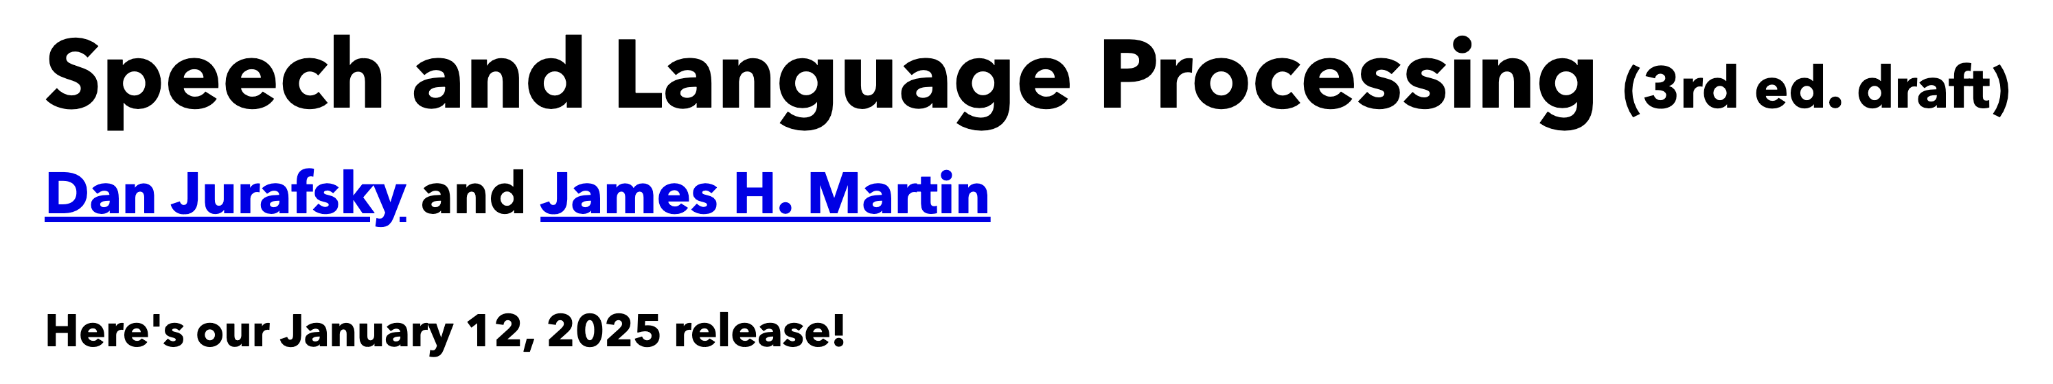
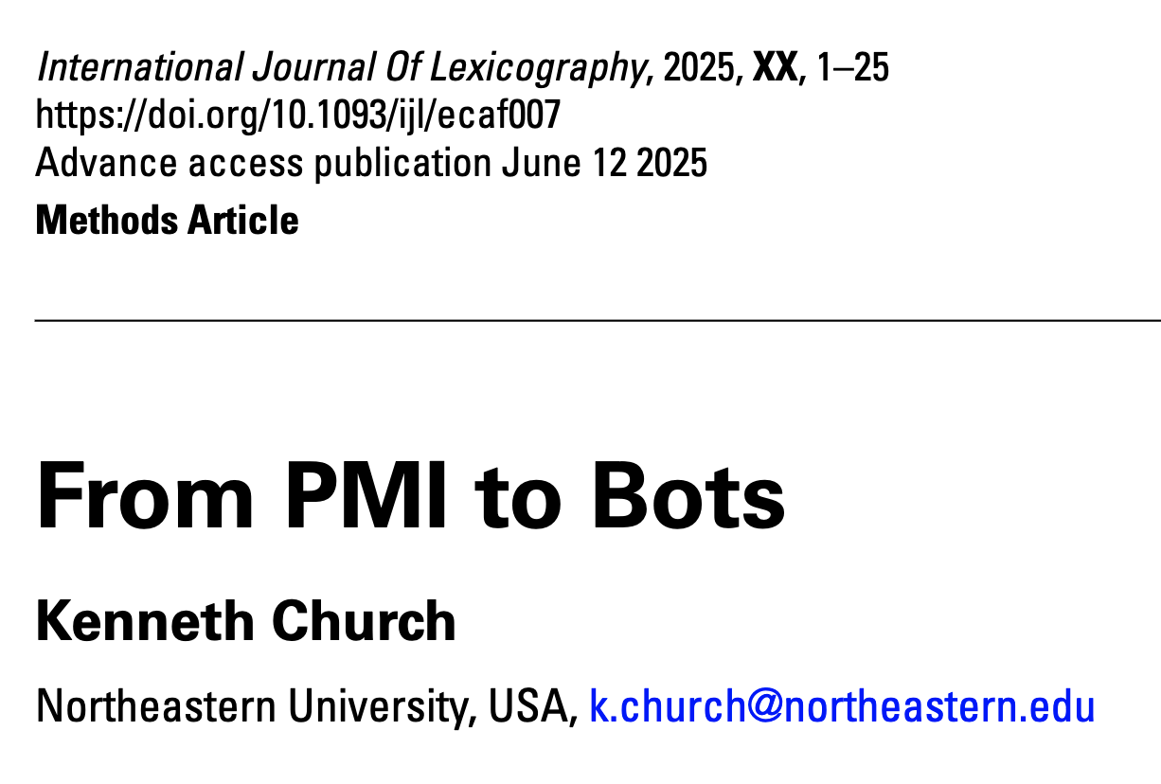
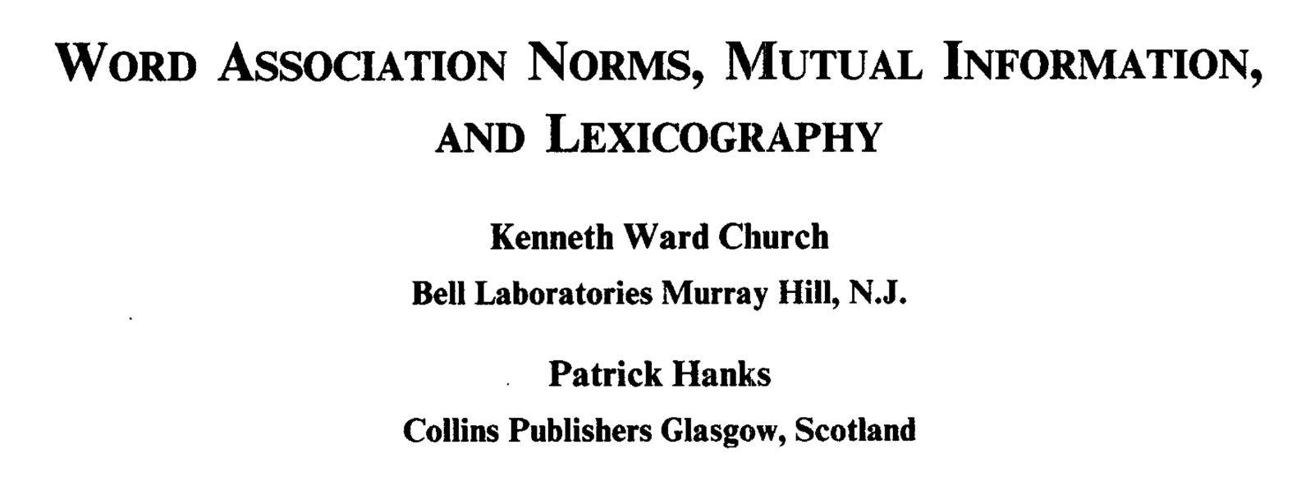
Background Reading for Today
JM: Chapter 6 (especially 6.6)
Word Association Norms, Mutual Information, and Lexicography
https://aclanthology.org/J90-1003/
From PMI to Bots (optional)

Slide 3

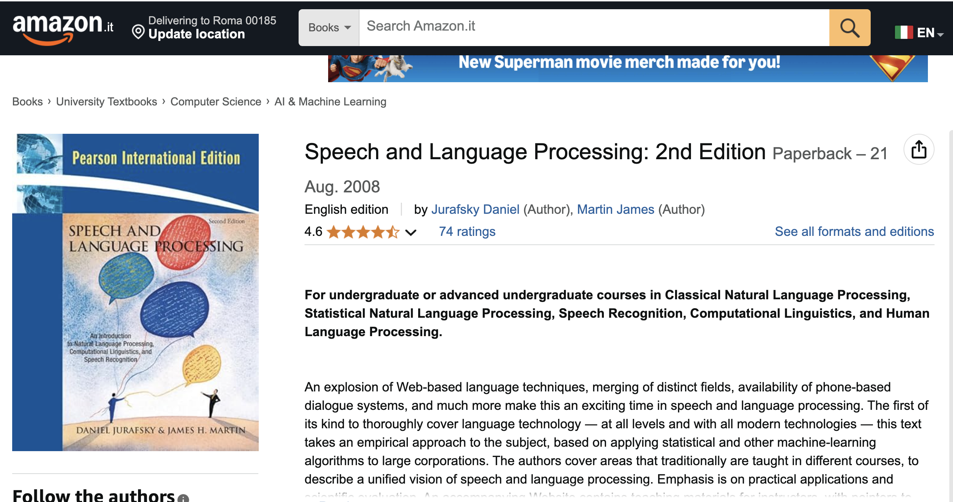
Textbook https://web.stanford.edu/~jurafsky/slp3/ JM: Chapter 6 (especially 6.6)

Slide 4
Chapter 6: Vector Semantics and Embeddings
Without Embeddings
With Embeddings
6.1: Lexical Semantics
6.2: Vector Semantics
6.3: Words and Vectors
6.4: Cosines (Similarity)
6.5: Term Weighting
6.6: Pointwise Mutual Information (PMI)
6.7: Apps of TF-IDF & PMI
6.8: Word2Vec
6.9: Visualizing Embeddings
6.10: Semantic Properties of Embeddings
6.11: Bias and Embeddings
6.12: Evaluating Vector Models
6.13: Summary

Slide 5
Bigger Picture
Connecting the Dots
CogSci: Interdisciplinary
Past, Present and Future
Where have we been and where are we going?
Psychology
Psycholinguistics
Humanities
Linguistics
Syntax, Semantics, Phonology, Phonetics, Phonetics
Lexicography
Education: Standardized Testing (Vocabulary Size)
Math
Statistics & Linear Algebra
Engineering
Artificial Intelligence
Machine Learning
Computational Linguistics
Machine Translation
Information Retrieval
Speech
Vision
Past: PMI
Present
Future: Bots

Slide 6
From PMI to Bots Connecting the dots between the past and the future
PMI → Word2Vec → Bots
PMI (Past): Pointwise Mutual Information
Original Motivation for PMI:
Help Lexicographers to find interesting “collocations”
Need to explain “collocations”
and connect the dots between collocations and lexical semantics
Word2Vec: factored representation of PMI
Bots (Future): Word2Vec → Doc2Vec

Slide 7


https://www.chronicle.com/article/im-a-student-you-have-no-idea-how-much-were-using-chatgpt

Slide 8
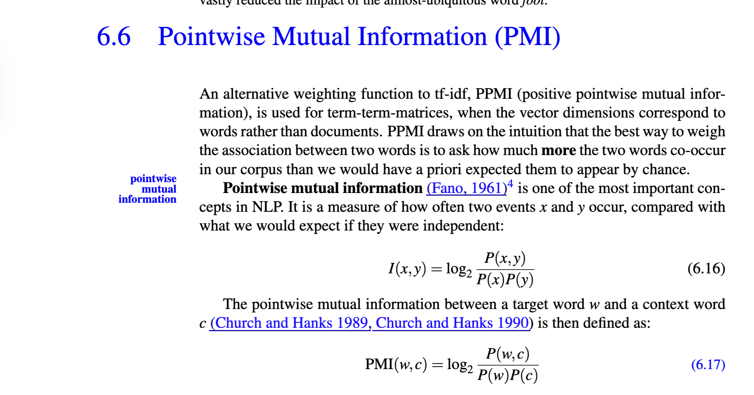
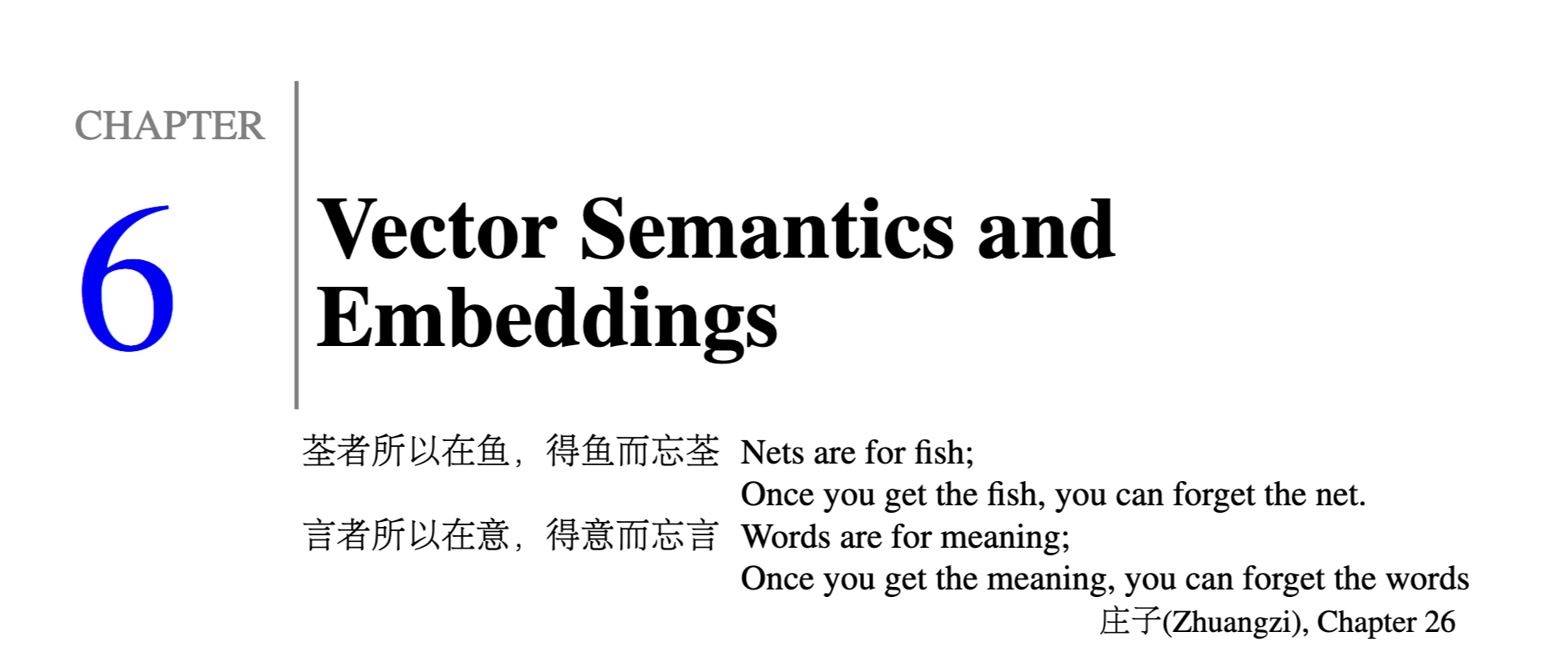

Slide 9

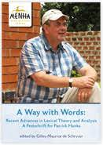
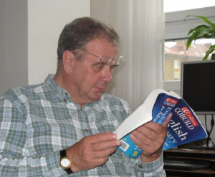

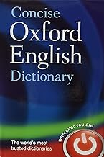
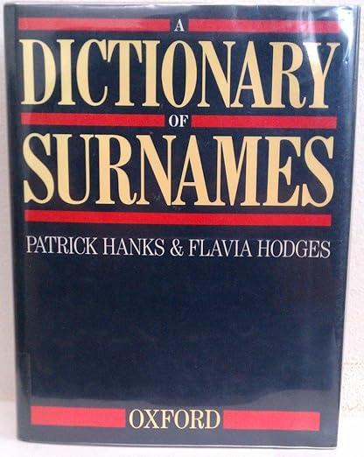
Special Issue of International Journal of Lexicography in Memory of Patrick Hanks

Slide 10
Agenda
Lexical Semantics
Word Associations
Information Theory
Computational Linguistics
PMI: Connecting the dots
Bots: Past → Present → Future

Slide 11
Lexical Semantics

Slide 12
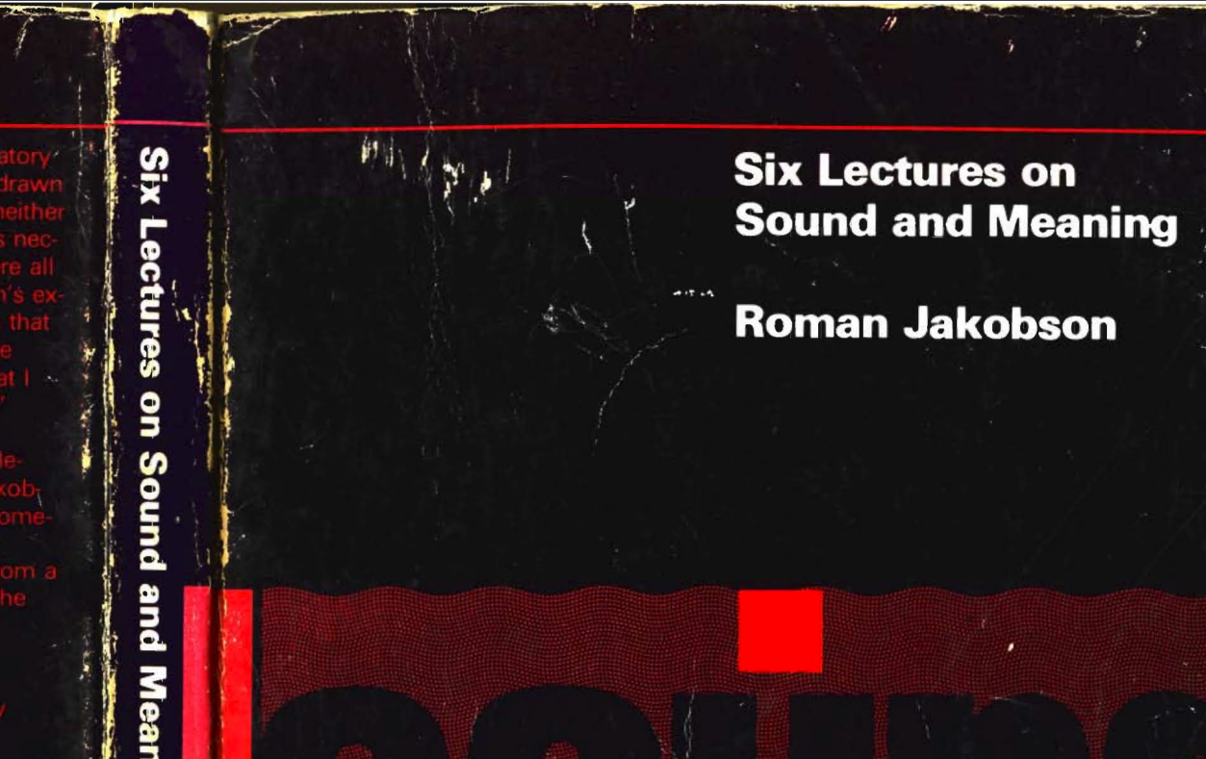
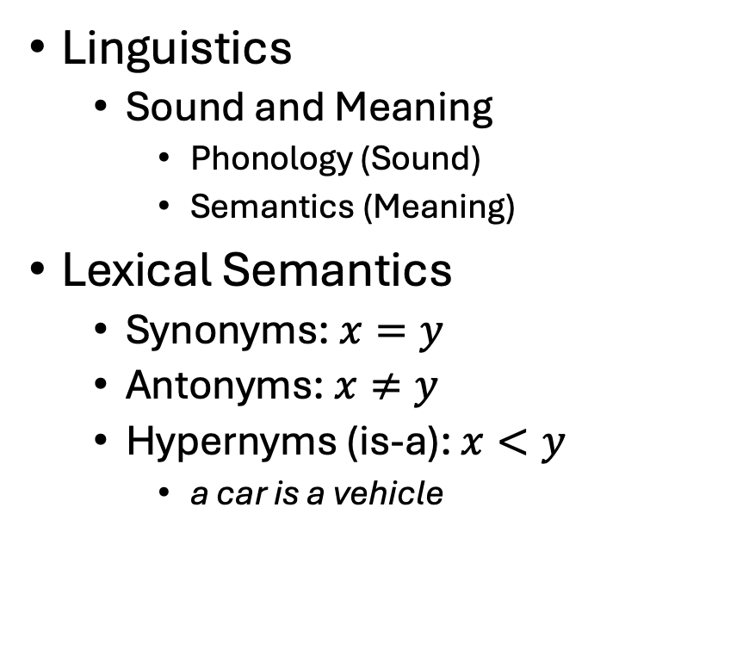
Vectors →Lexical Semantics
Linguistics
Sound and Meaning
Phonology (Sound)
Semantics (Meaning)
Lexical Semantics
Synonyms: $x=y$
Antonyms: $x≠y$
Hypernyms (is-a): $x<y$
a car is a vehicle
Related Topics
Ontologies
Semantic Networks
WordNet
Vectors:
More modern view of meaning
Behind much of the recent excitement in AI
Large Language Models (LLM)
Bots: ChatGPT, DeepSeek

Slide 13
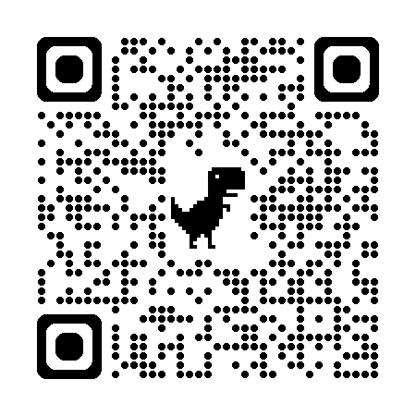
So far
Jurafsky’s Slide 17
Word-Sense Disambiguation
Concepts or word senses
Have a complex many-to-many association with words (homonymy, multiple senses)
Have relations with each other
Synonymy
Antonymy
Similarity
Relatedness
Connotation
Collocations
Collocations
Collocations
https://web.stanford.edu/~jurafsky/slp3/slides/vectorsemantics2024.pdf

Slide 14
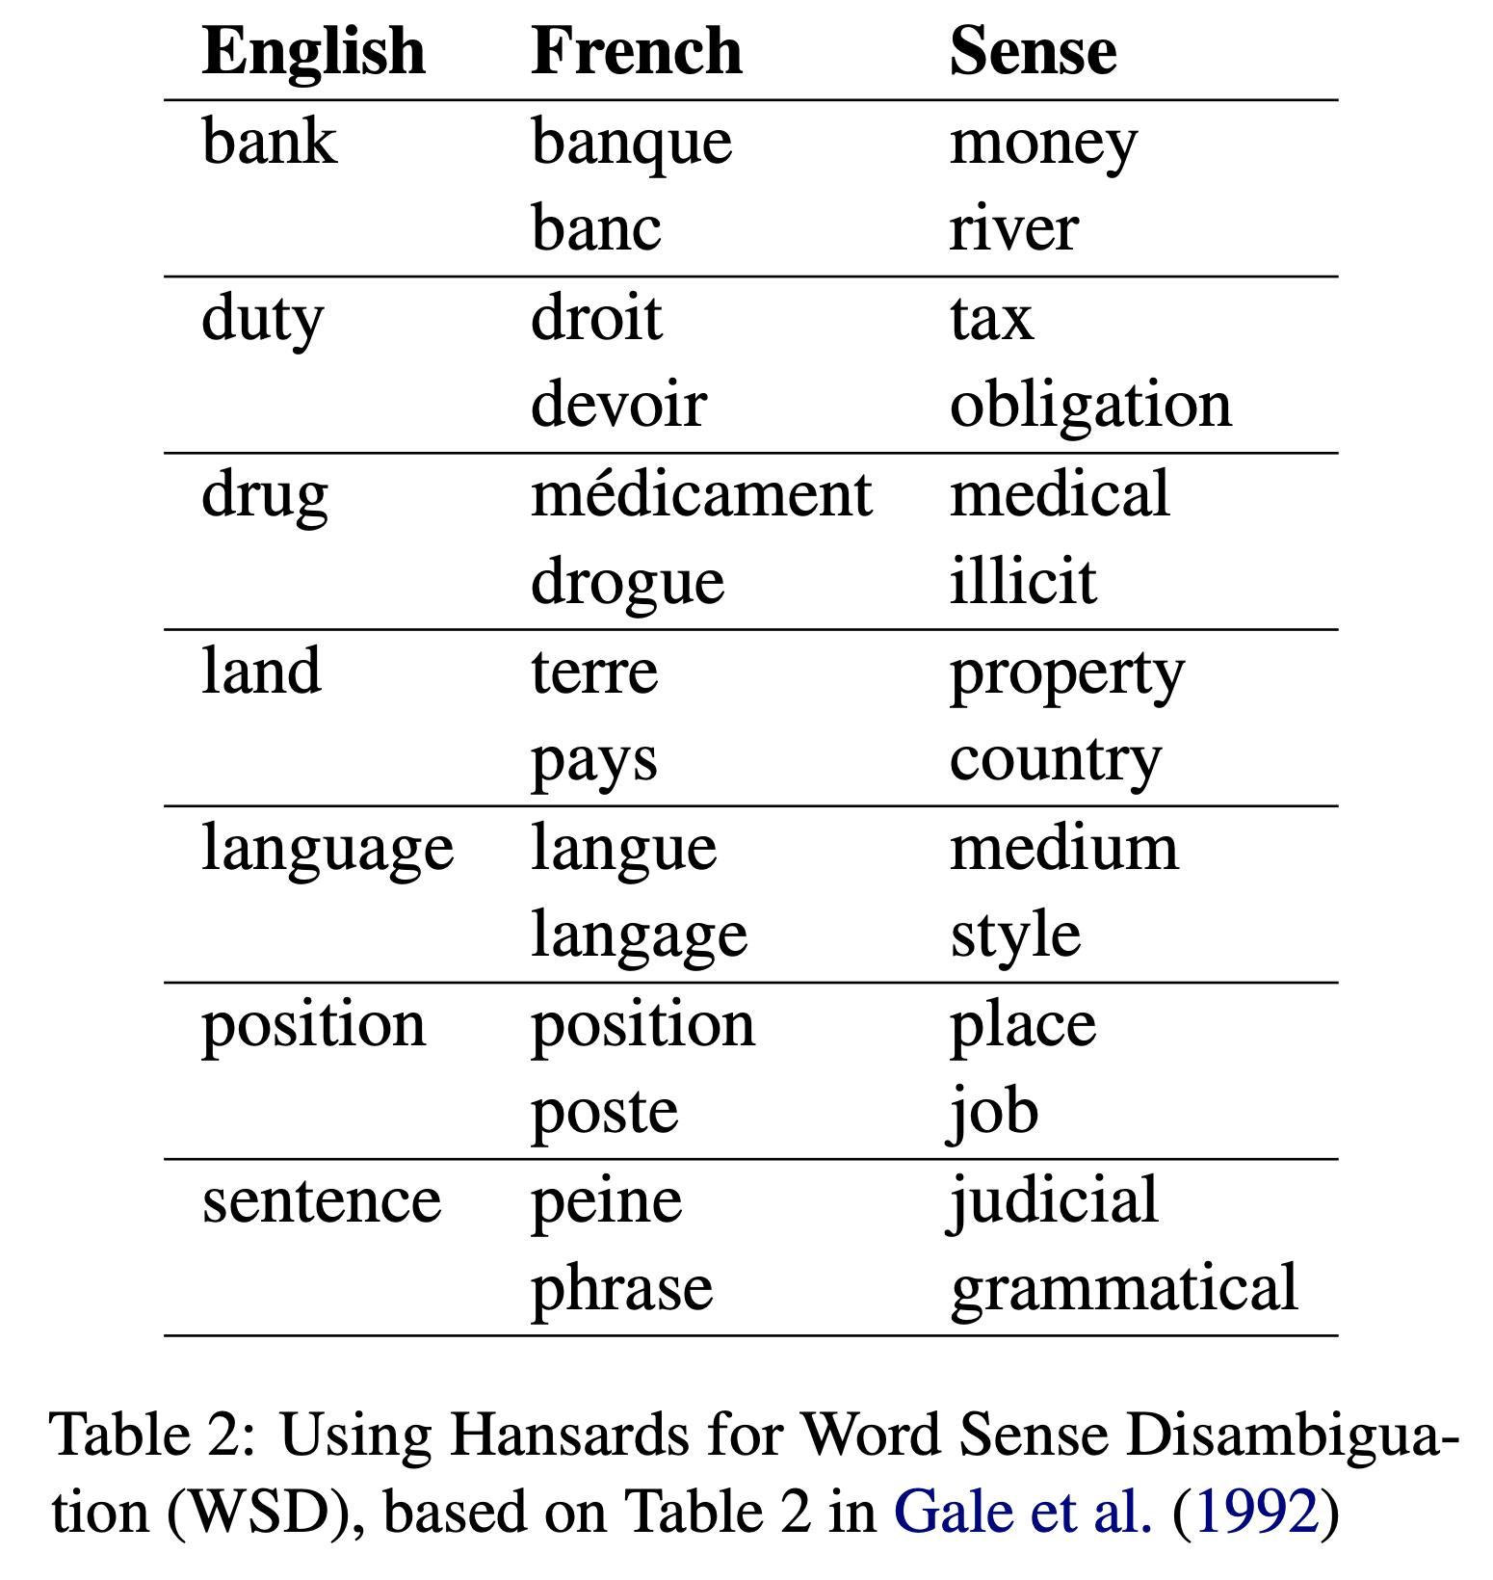
Word Sense Disambiguation (WSD)
Data (Corpus): Hansards
Parliamentary Debates (Canada)
Canada is a bilingual country
Debates are published in both official languages
Translation depends on sense
Bar-Hillel (1960) gave up on Machine Translation (MT)
Because he thought WSD was too hard (“AI-Complete”)
Gale, Yarowsky and I revived interest in WSD in 1990s
by showing how to
take advantage of Hansards

Slide 15
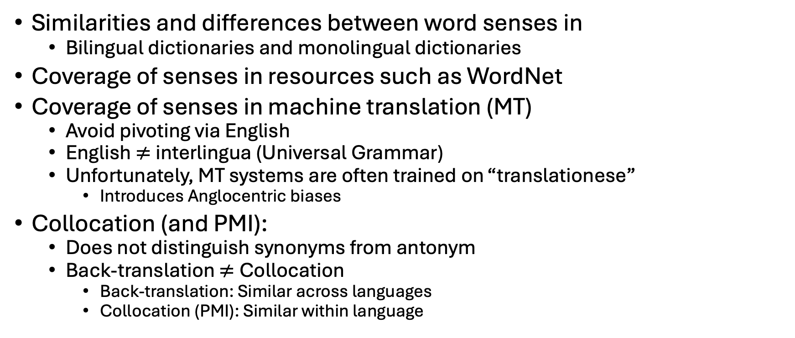
More advanced questions
Similarities and differences between word senses in
Bilingual dictionaries and monolingual dictionaries
Coverage of senses in resources such as WordNet
Coverage of senses in machine translation (MT)
Avoid pivoting via English
English $≠$interlingua (Universal Grammar)
Unfortunately, MT systems are often trained on “translationese”
Introduces Anglocentric biases
Collocation (and PMI):
Does not distinguish synonyms from antonym
Back-translation $≠$Collocation
Back-translation: Similar across languages
Collocation (PMI): Similar within language

Slide 16
Avoid Translation (Pivoting via English) https://www.nltk.org/howto/wordnet.html
WordNet
Word Sense Disambiguation (WSD)
wn.synset('dog.n.01').lemma_names('fra')
['canis_familiaris', 'chien']
wn.synset('cat.n.01').lemma_names('fra')
['chat']
wn.synset('house.n.01').lemma_names('fra')
['maison']
wn.synset('bank.n.01').lemma_names('fra')
['banque', 'rive’]
Assumes English ontology is universal
Ontology: is-a links between synsets, etc.
Supports 32 languages

Slide 17
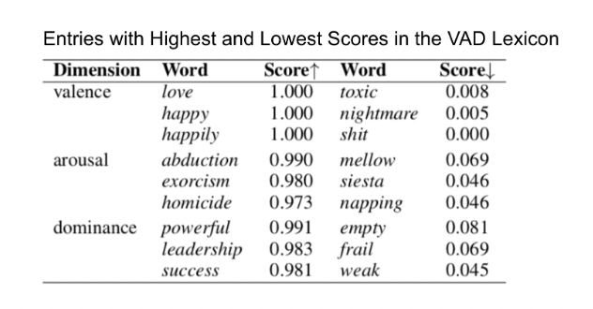
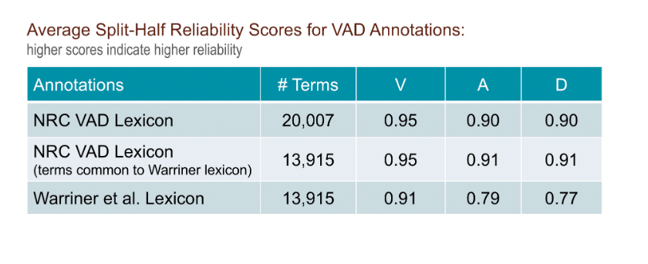
Avoid Translation (Pivoting via English) NRC-VAD https://saifmohammad.com/WebPages/nrc-vad.html
Hausa | English | Valence | Arousal | Dominance
aaaaaaa | aaaaaaah | 0.48 | 0.61 | 0.29
aaaah | aaaah | 0.52 | 0.64 | 0.28
ardvark | aardvark | 0.43 | 0.49 | 0.44
abin mamaki | aback | 0.39 | 0.41 | 0.29
abacus | abacus | 0.51 | 0.28 | 0.49
abalone | abalone | 0.50 | 0.48 | 0.41
Assumes English ontology is universal

Slide 18
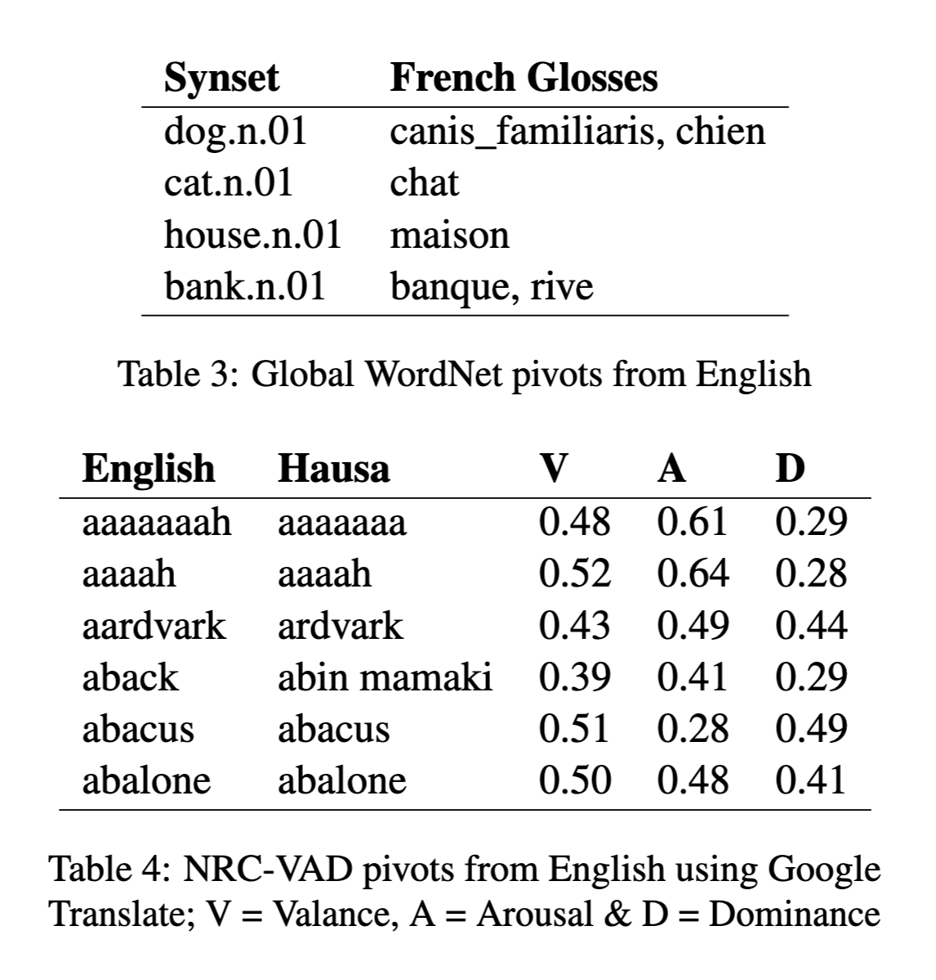
Avoid Pivoting from English
WordNet
VAD: Valance, Arousal, Dominance

Slide 19
Examples >> Definitions: “Erode” (George Miller: Chomsky’s Mentor, Magic Number 7, WordNet)
Exercise: Use “erode” in a sentence:
My family erodes a lot.
to eat into or away; destroy by slow consumption or disintegration
Battery acid had eroded the engine.
Inflation erodes the value of our money.
Miller’s Conclusion:
Dictionary examples are more helpful than definitions
Effective examples:
Make heavy use of collocations
Definition
Examples
6/27/2014
Fillmore Workshop
19

Slide 20
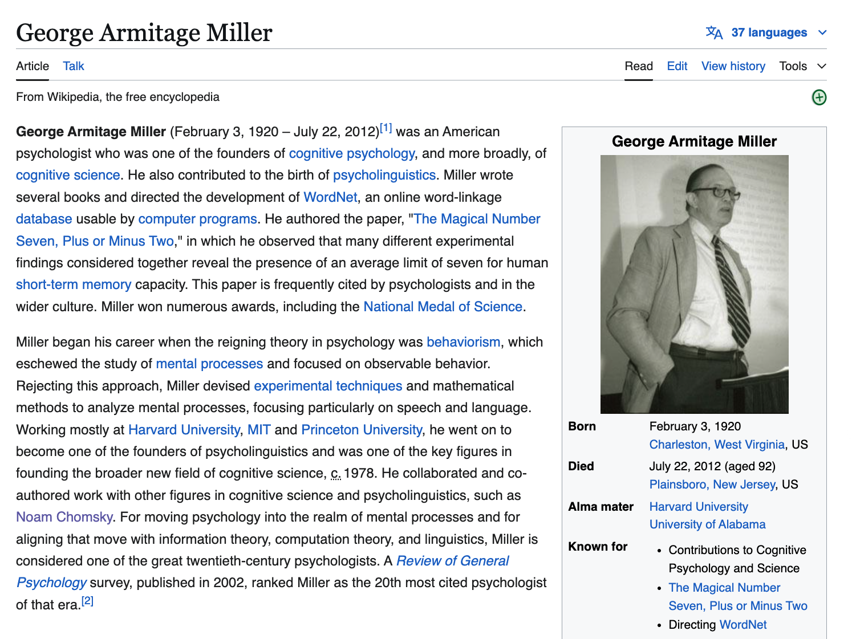
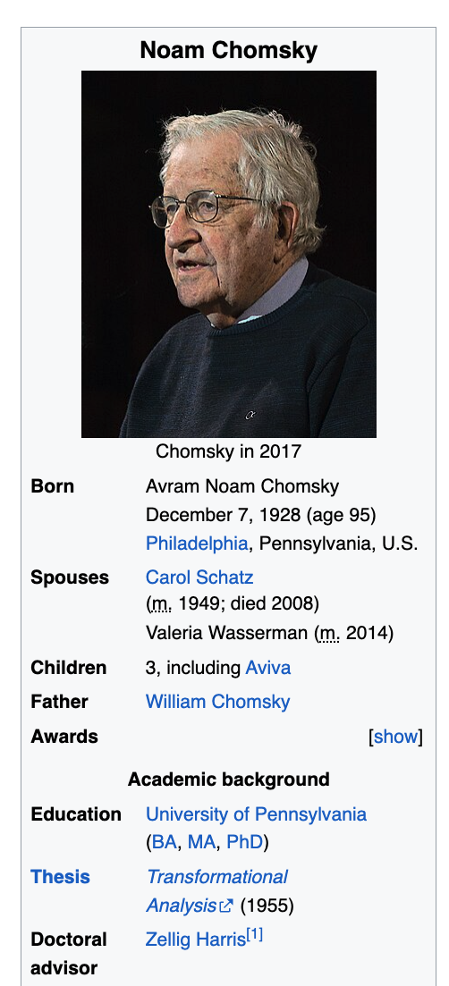

Slide 21
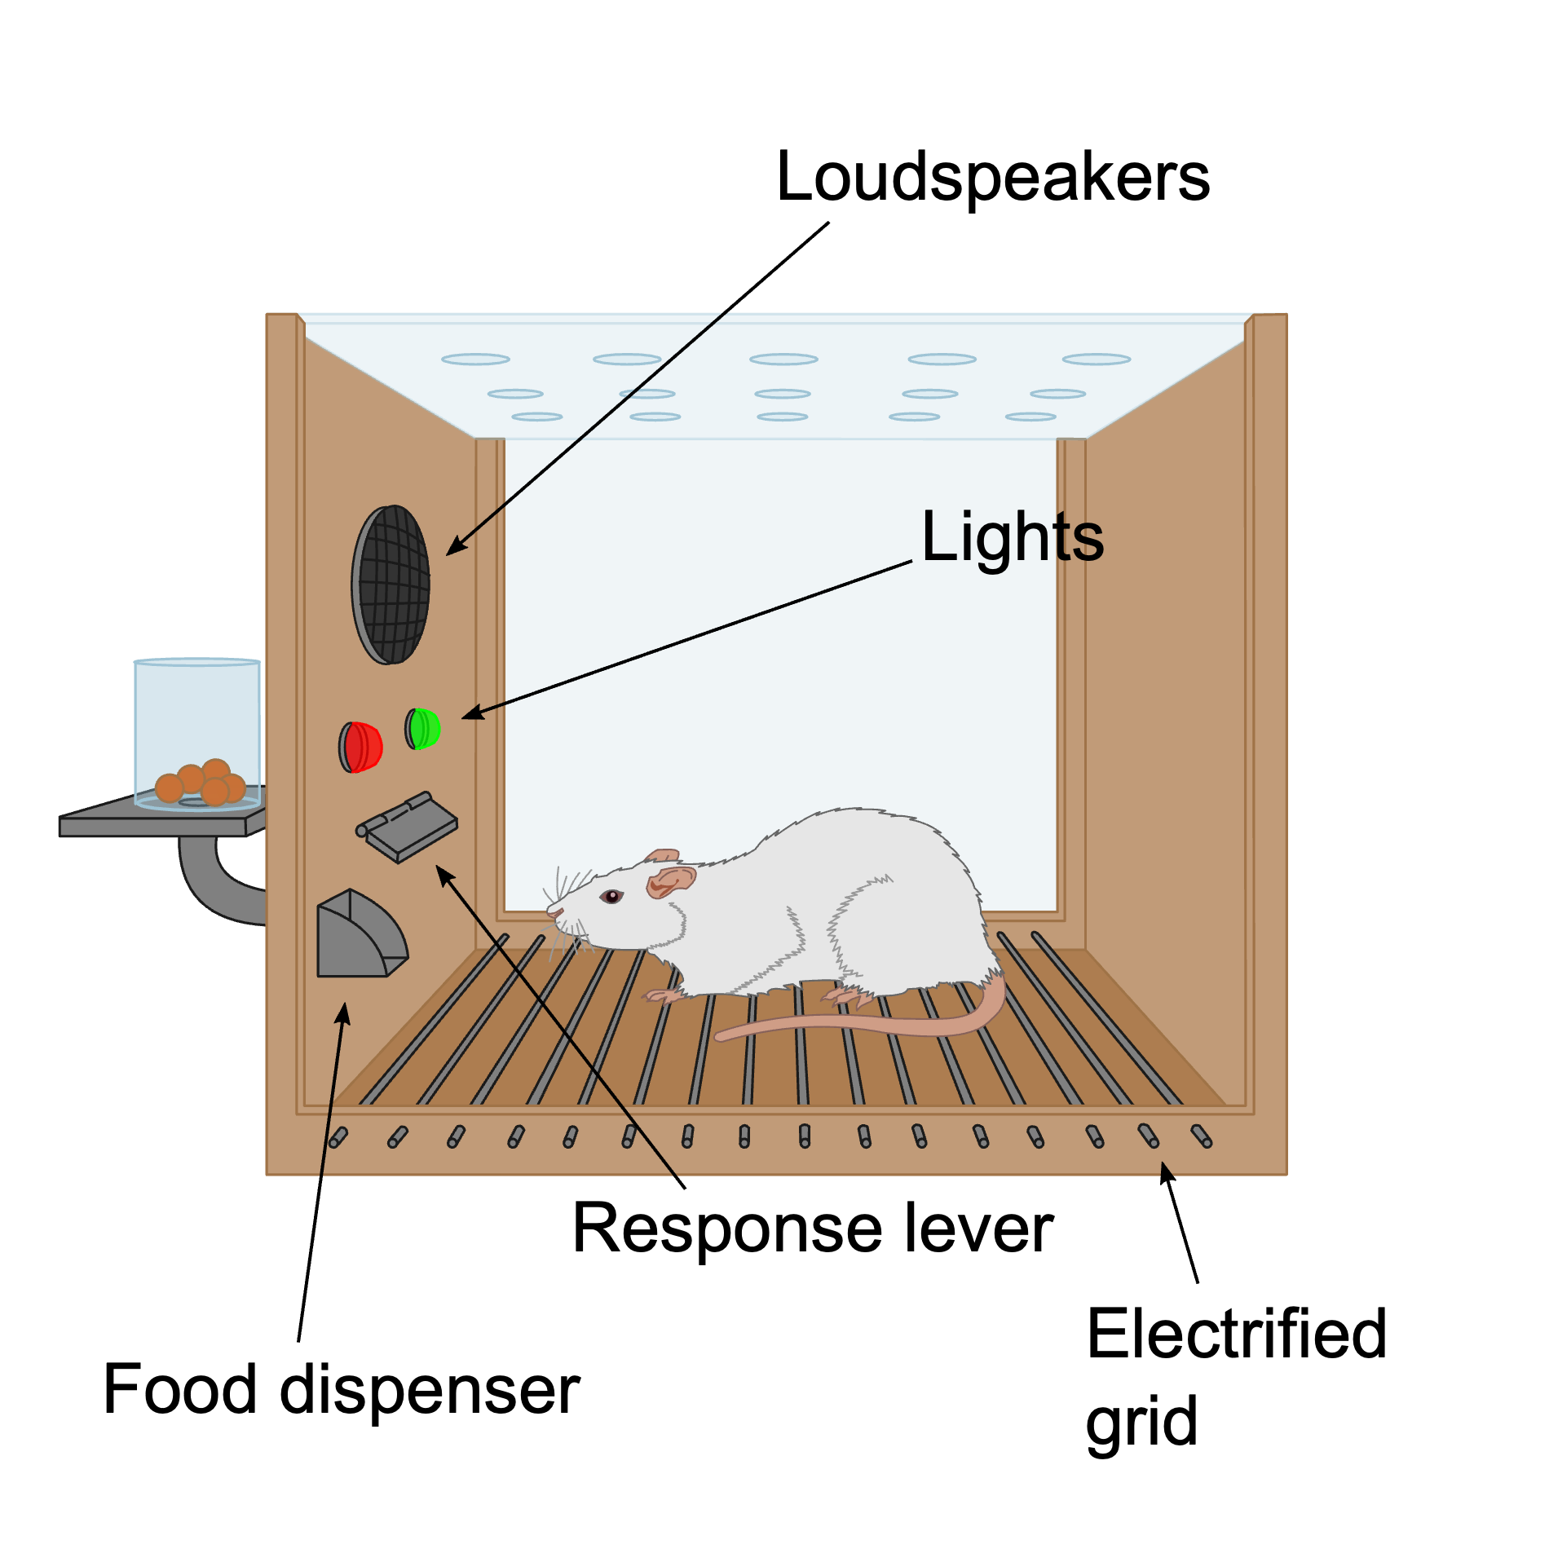
Cognitive Science & Harvard in 1950s
CogSci
George Miller
Noam Chomsky (Linguistics)
Marvin Minsky (AI)
Behaviorism
BF Skinner
my father
Q: Have I ever been in a Skinner box?
A: Yes
Empiricism
Zipf
By Original: AndreasJS Vector: Pixelsquid - This file was derived from: Skinner box scheme 01.png: by AndreasJS, CC BY-SA 3.0, https://commons.wikimedia.org/w/index.php?curid=99322433

Slide 22
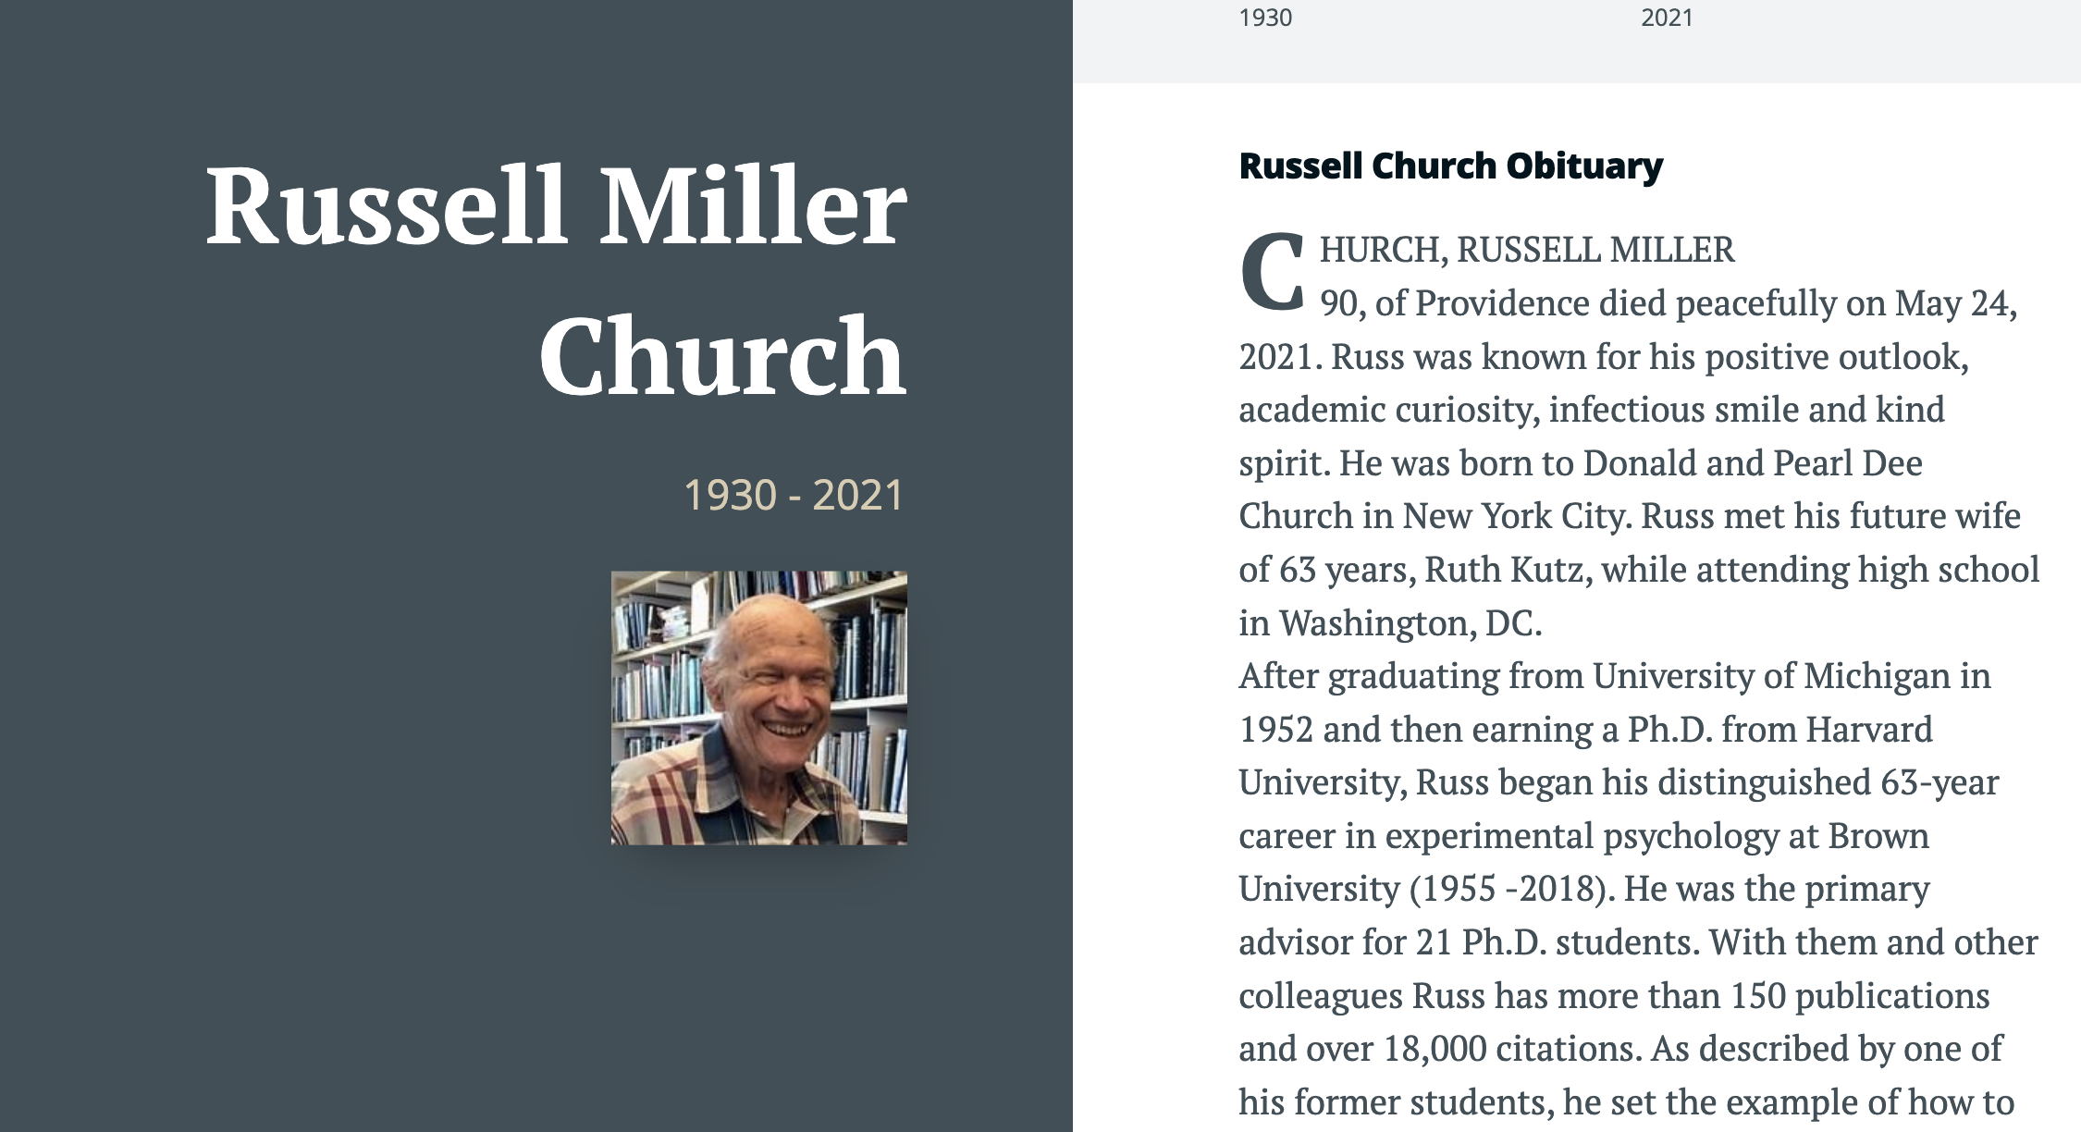

Slide 23
Agenda
Lexical Semantics
Word Associations
Information Theory
Computational Linguistics
PMI: Connecting the dots
Bots: Past → Present → Future

Slide 24
Word Associations

Slide 25
https://en.wikipedia.org/wiki/Gestalt_psychology
“atomism,” also known as “elementalism,’’
the view that all knowledge, even complex abstract ideas, is built from simple, elementary constituents
“sensationalism,”
the view that the simplest constituents—the atoms of thought—are elementary sense impressions
“associationism,”
the view that more complex ideas arise
from the association of simpler ideas.
PMI: Word Associations

Slide 26
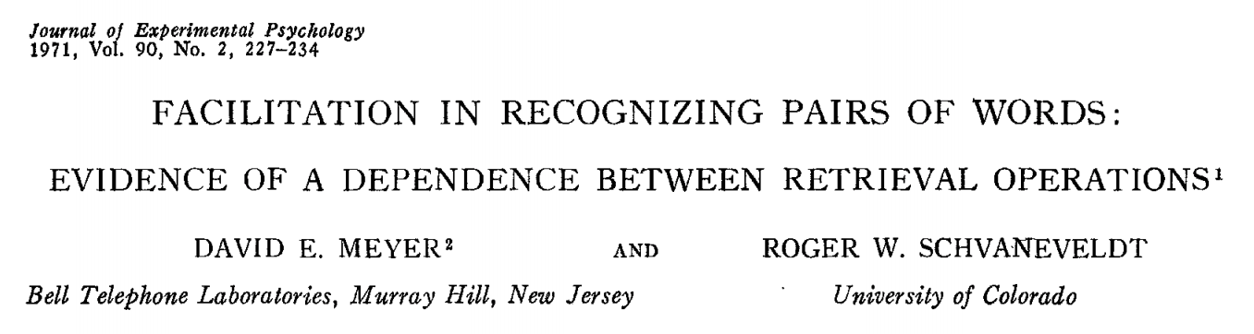
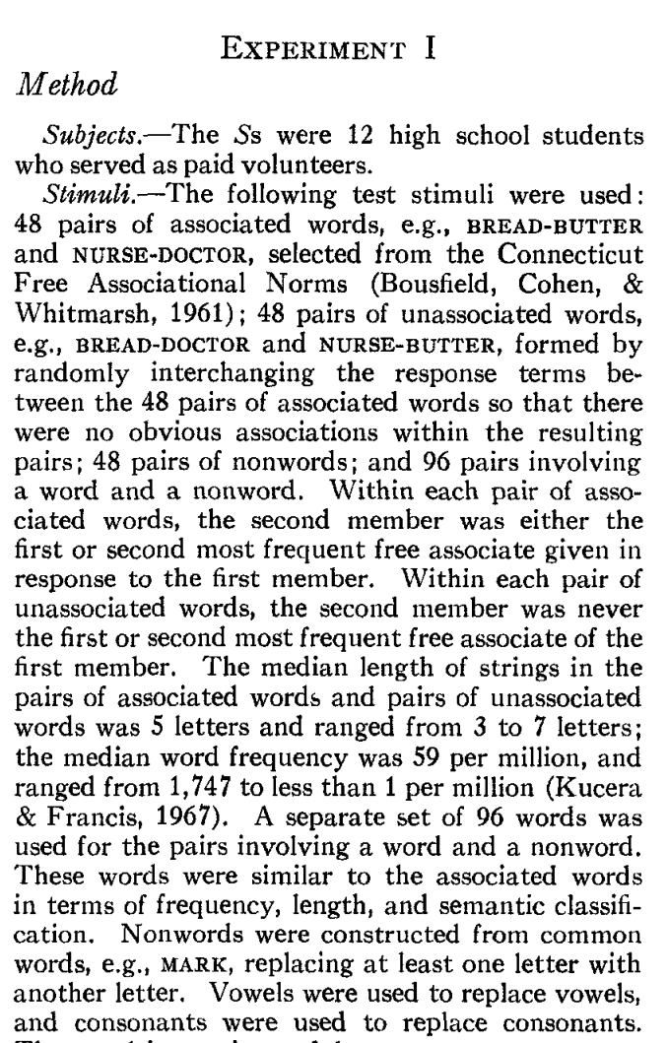
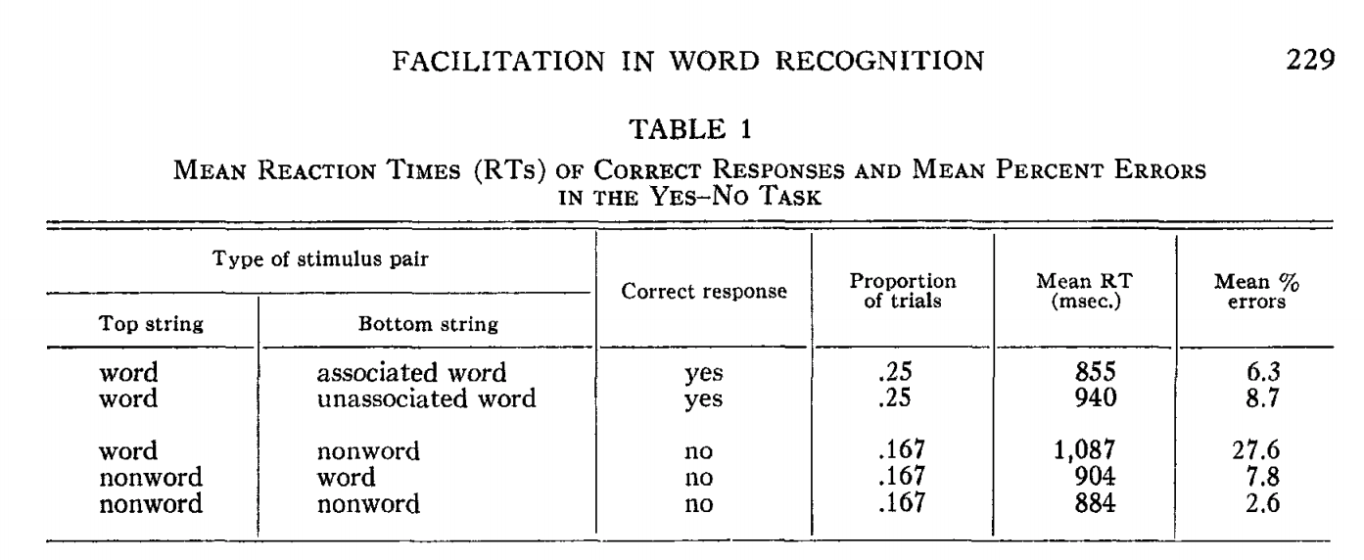
Priming & Word Associations Task: Subject is given two strings and responds “yes” if both are words

Slide 27

Size of Priming Effect (from previous slide): 855 msec v. 940 msec
System 1 vs System 2
Fast (Unconscious)
Slow
Rules of Thumb
500 msec:
Push a button after tone
1000 msec: Lexical retrieval
Push one button for words and another for non-words
Longer: System 2
Explain your work

Slide 28
Size of Priming Effect (from previous slide): 855 msec v. 940 msec
Kahneman, Daniel.
Thinking, Fast and Slow (pp. 20-21)
Kindle Edition.
System 1 operates automatically and quickly,
with little or no effort and
no sense of voluntary control.
System 2 allocates attention to the effortful mental activities that demand it, including complex computations.
The operations of System 2 are often associated with the subjective experience of agency, choice, and concentration.

Slide 29
Size of Priming Effect (from previous slide): 855 msec v. 940 msec
Consequences for AI
Large Language Models (LLMs)
Deep Networks
ChatBots (ChatGPT)
RAG
Thus far, AI is more effective for System 1 than System 2
What about coding?
That sounds like a System 2 task
But Bots code by table lookup
More like lexical retrieval than problem solving

Slide 30
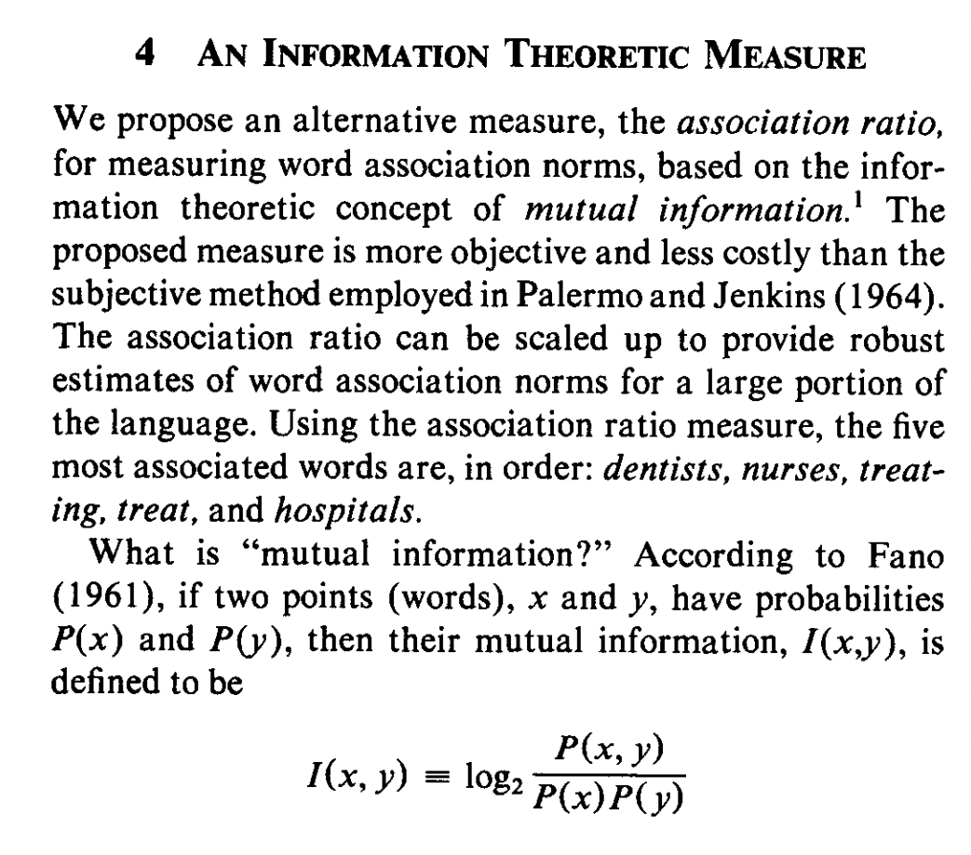
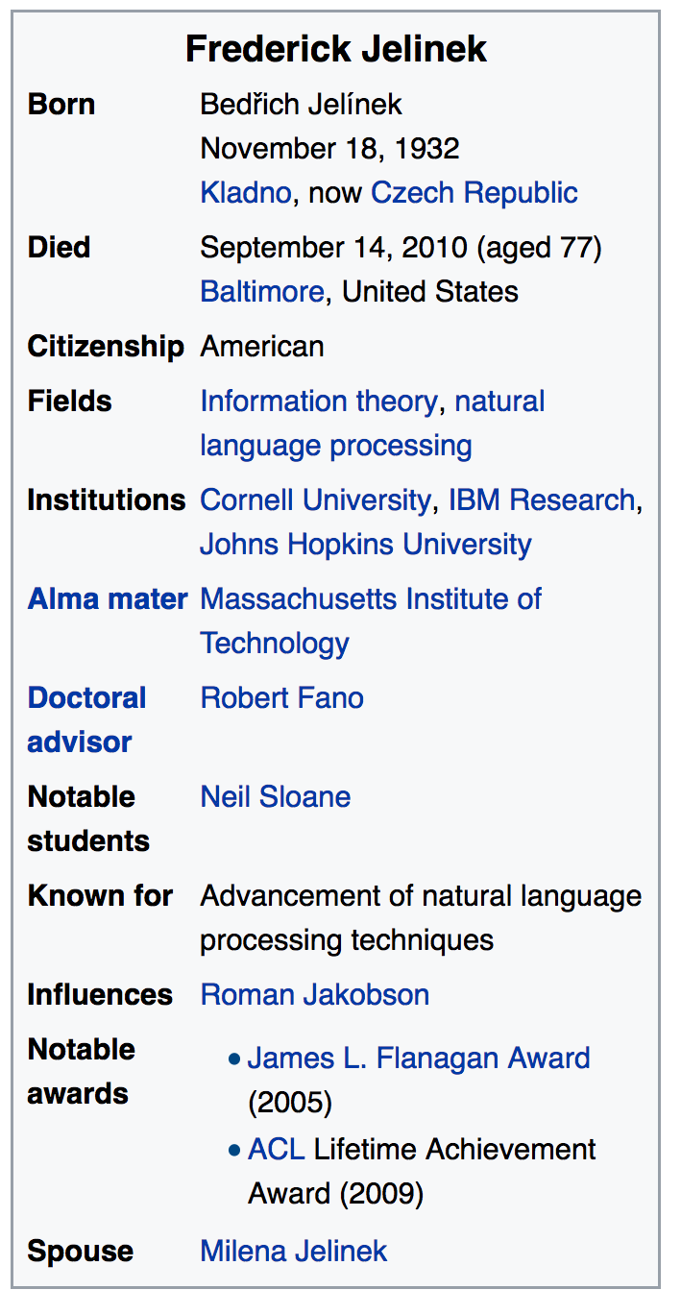
Pointwise Mutual Information (PMI)
Simple interpretation
PMI compares P(x,y) with chance
Chance = P(x) P(y)
If there is a genuine association
then P(x,y) >> P(x) P(y)
Uninteresting associations
P(x,y) ≈ P(x) P(y)
Popular applications (lexicography)
more like hypothesis testing
focus on largest PMI
where we can reject null hypothesis
null hypo: uninteresting
less like language modeling for speech and machine translation

Slide 31
Agenda
Lexical Semantics
Word Associations
Information Theory
Computational Linguistics
PMI: Connecting the dots
Bots: Past → Present → Future

Slide 32
Information Theory

Slide 33
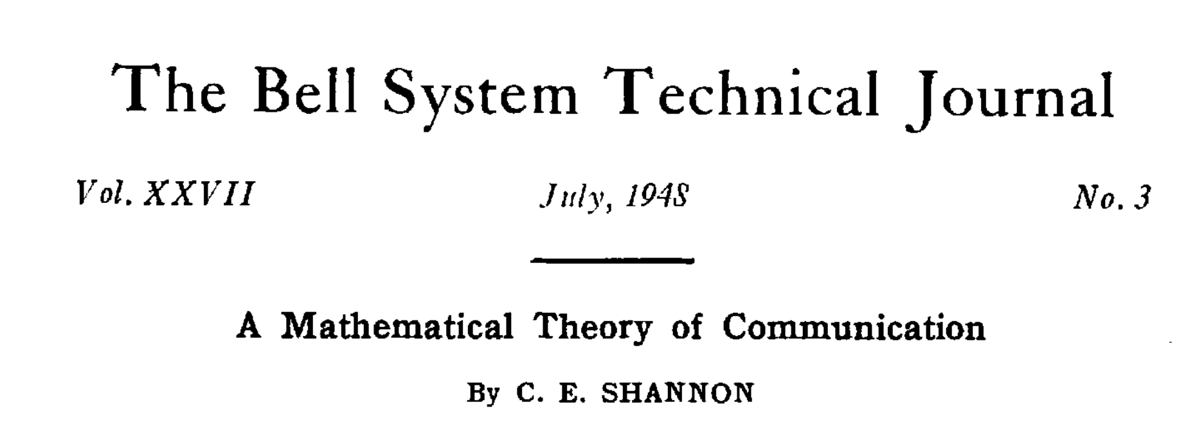
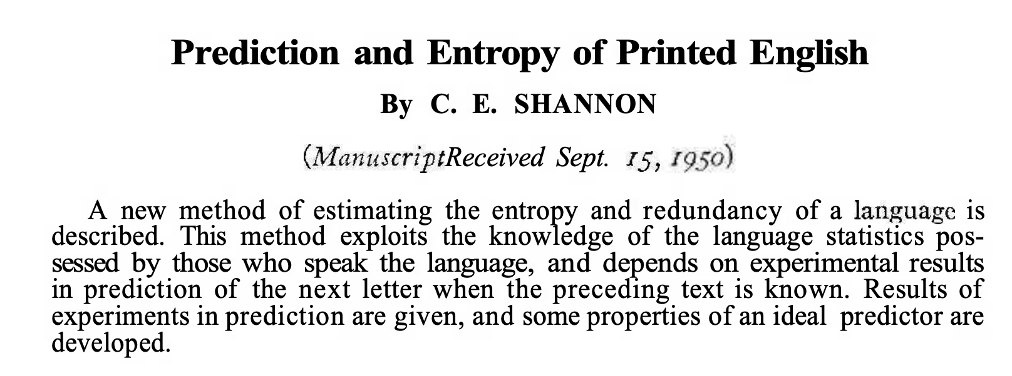

Slide 34
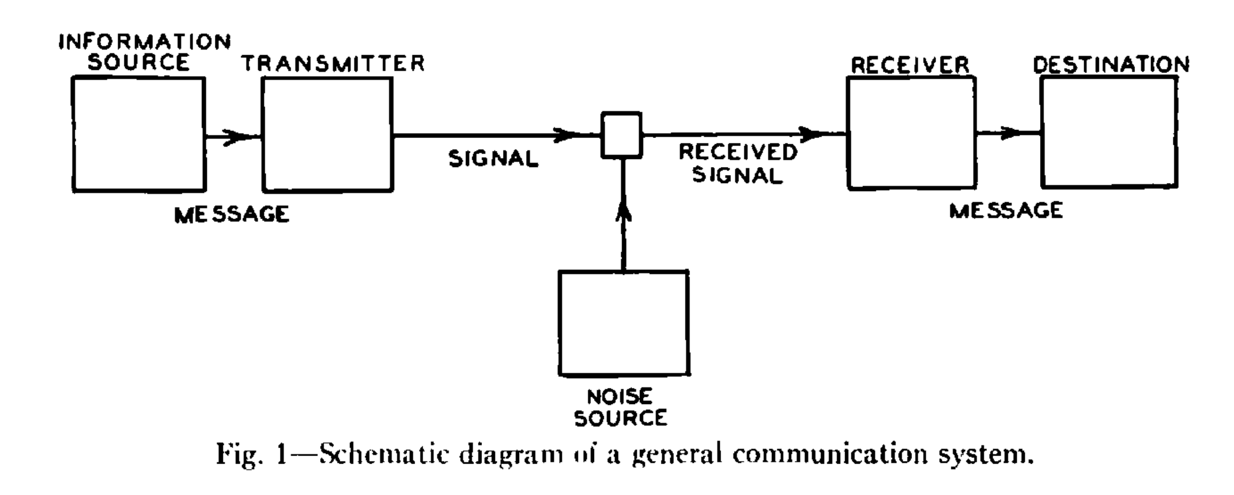

Slide 35
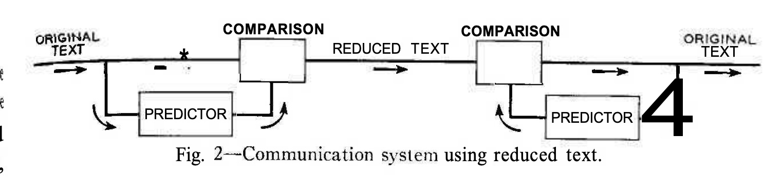

Slide 36
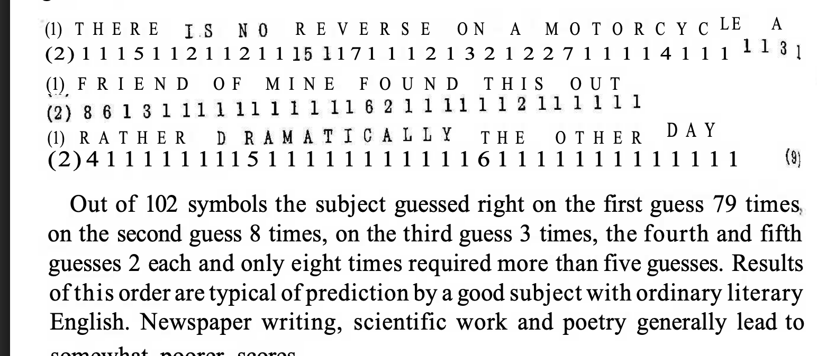

Slide 37
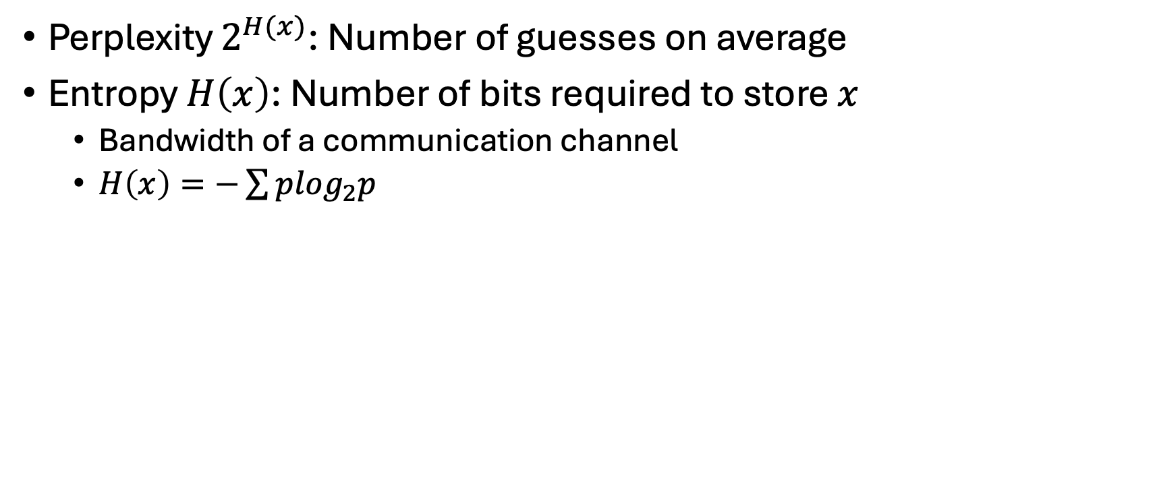
Perplexity & Entropy
Perplexity $2^{H(x)}$: Number of guesses on average
Entropy $H\left(x\right)$: Number of bits required to store $x$
Bandwidth of a communication channel
$H\left(x\right)=−\sum{p\log_{2}p}$

Slide 38
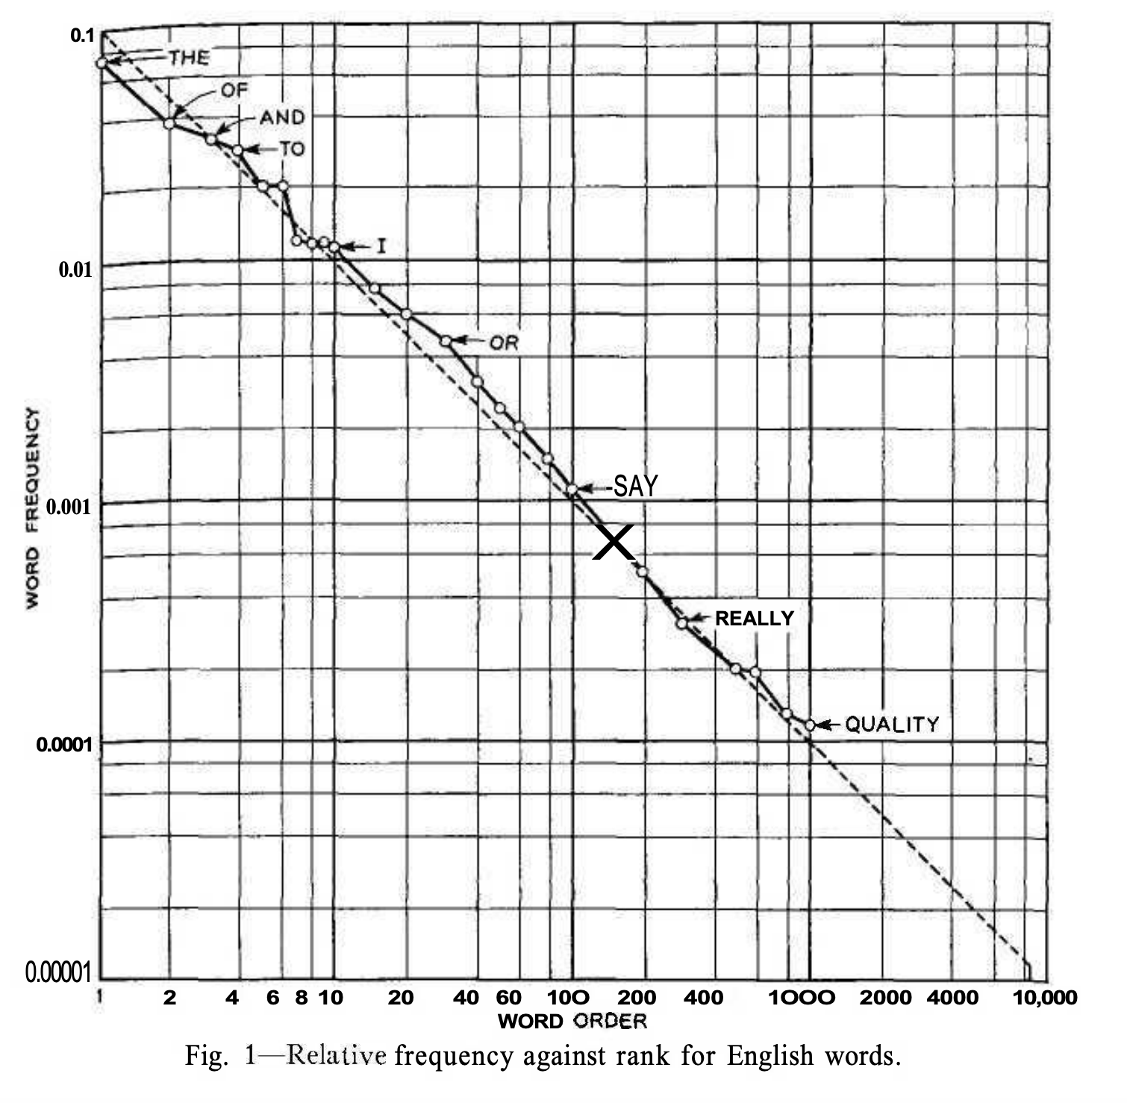
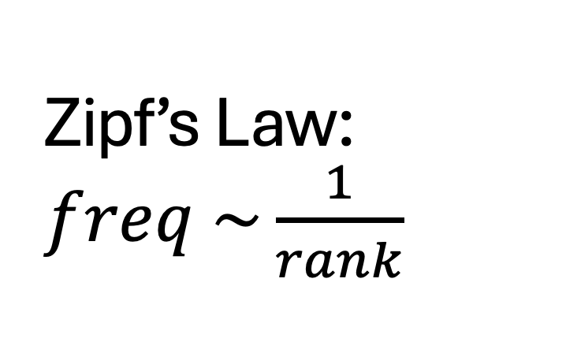
Zipf’s Law: $freq \sim \frac{1}{rank}$
Function Words
Content Words

Slide 39
Agenda
Lexical Semantics
Word Associations
Information Theory
Computational Linguistics
PMI: Connecting the dots
Bots: Past → Present → Future

Slide 40
Computational Linguistics

Slide 41
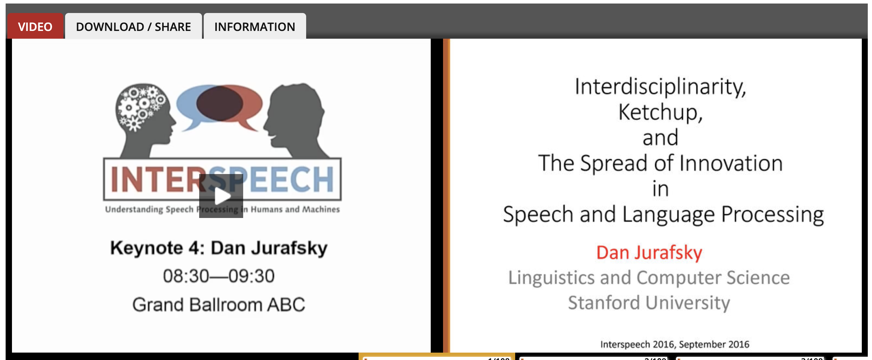
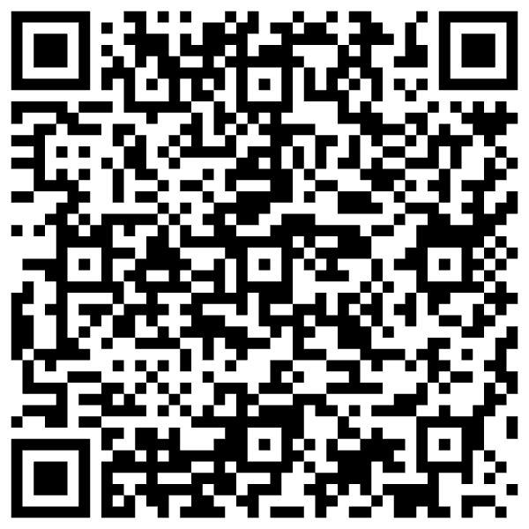
Jurafsky’s Spin on This History Jurafsky is author of Textbook (and “foodie”)

Slide 42
Topics to be discussed today
Motivations for PMI in
Lexicography (Hanks): Collocations
Engineering (Church): Bots
Use PMI as a foil to discuss
Past (1950s)
Psycholinguistics (Word Associations, Reaction Times)
Information Theory (Entropy, Perplexity)
Corpus-Based Methods (Lexicography → Engineering)
Future (Bots)
Vectors
Approximate Nearest Neighbors (ANN)

Slide 43
Corpus-Based Methods Lexicography → Engineering
Collect a sample of text (corpus)
Brown Corpus
British National Corpus (BNC)
Create Concordances
Also known as key word in context (KWIC)
Identify collocations
Organize concordances into patterns
Save <good> from <bad>

Slide 44
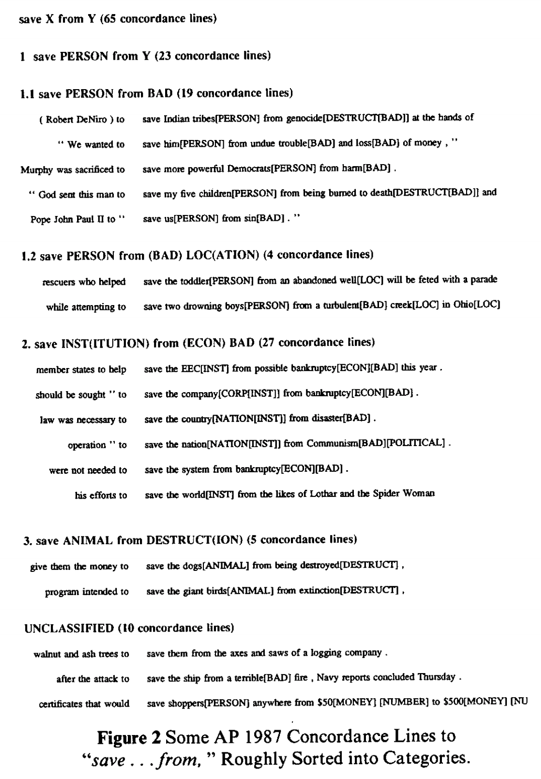
Save <good> from <bad>

Slide 45
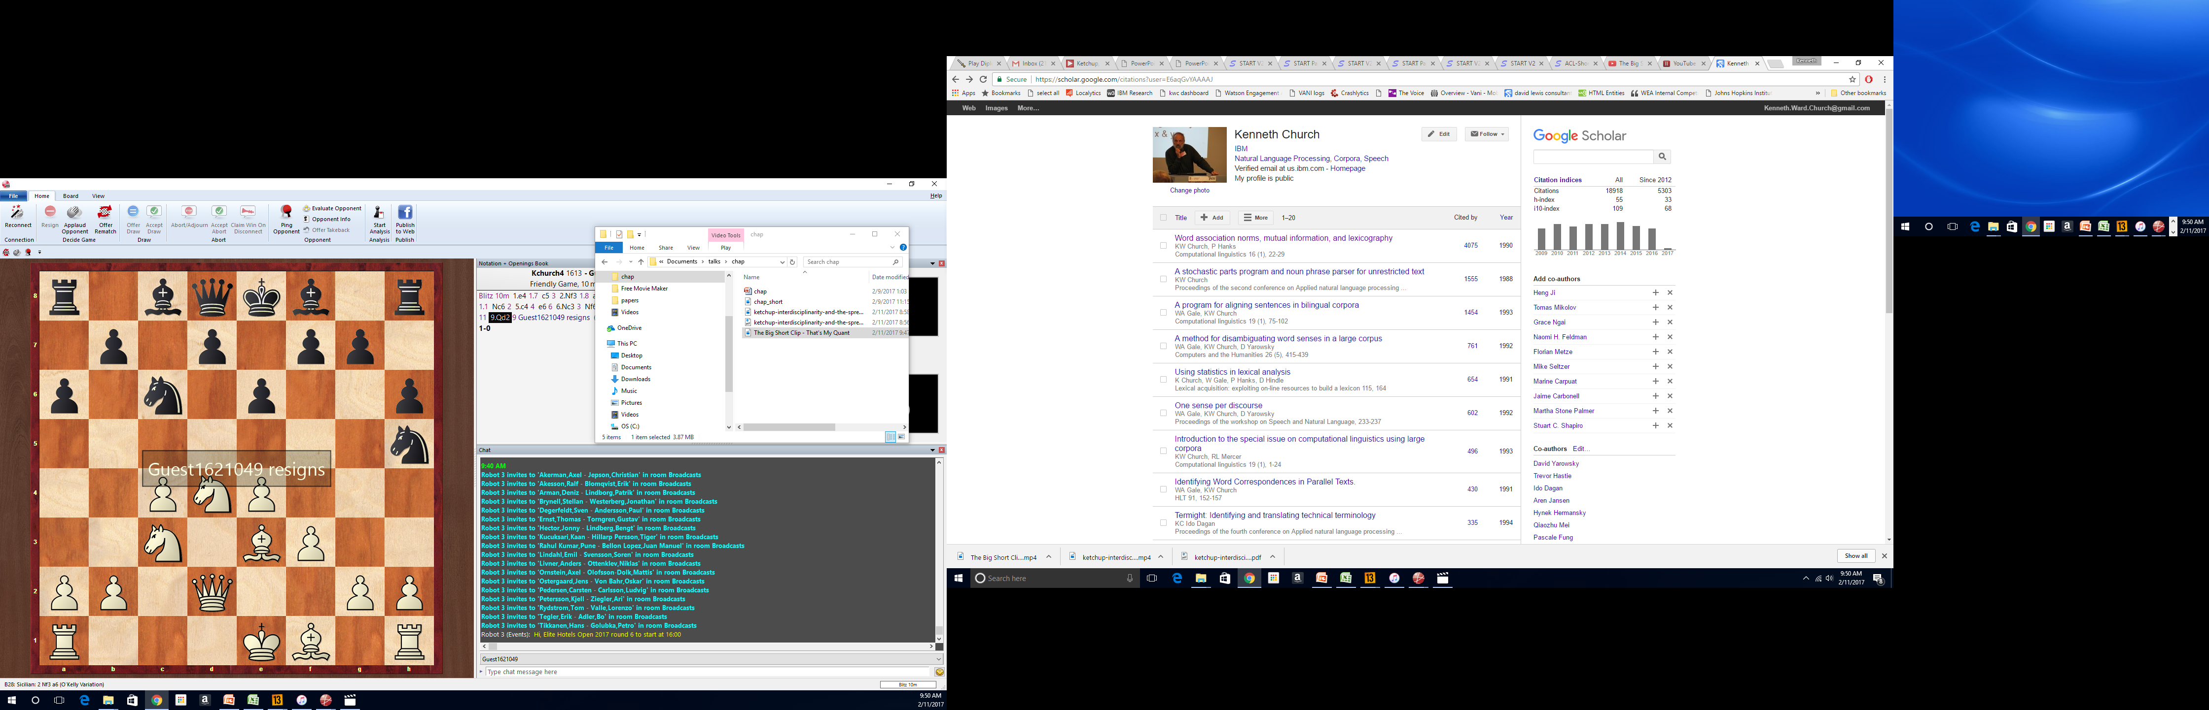
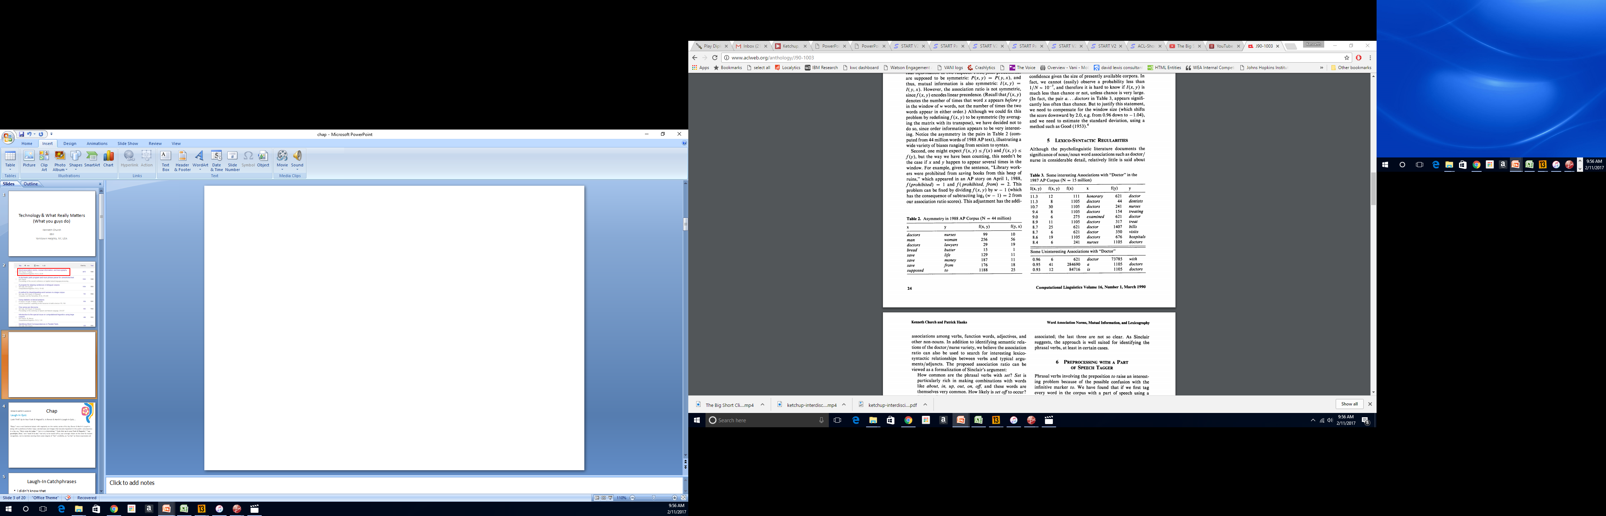
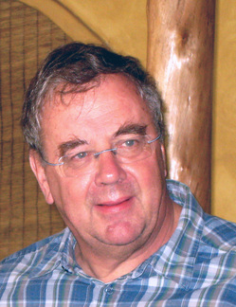

Slide 46
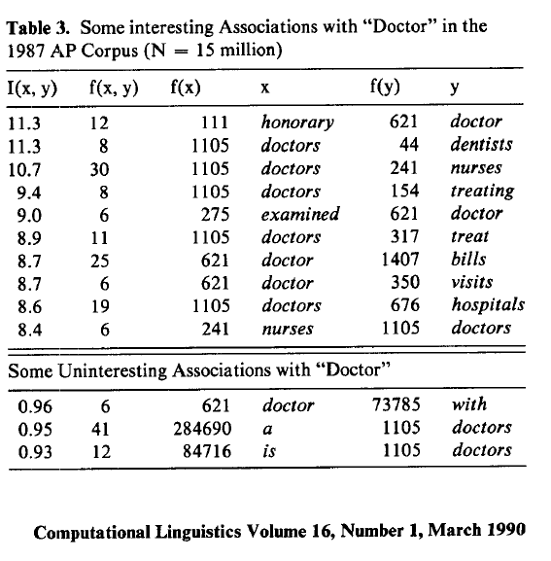
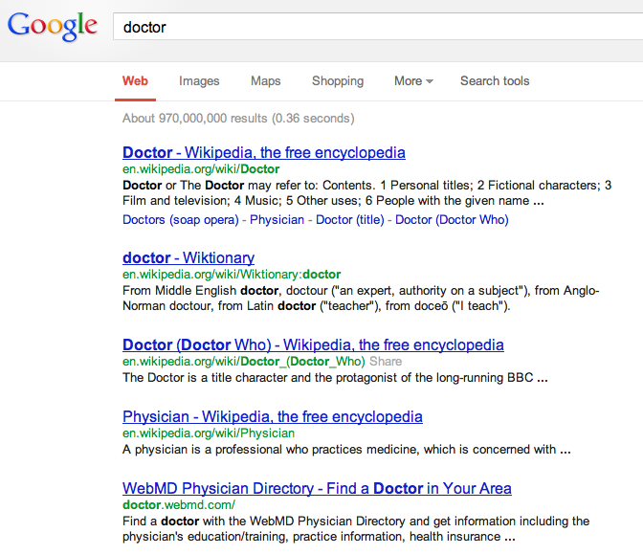
There is no data like more data
Counts are growing 1000x per decade
(same as disks)
Counts are growing 1000x per decade
(same as disks)
Rising Tide of Data Lifts All Boats

Slide 47
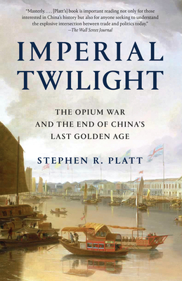

End-to-End Self-Organizing Systems v. Human-in-the-Loop
Collaboration with Hanks (PMI)
We always assumed
computer was in a supporting role.
It was my job to speed up drudgery
of reading concordances,
but it was not my job
to automate his job.
He loved most of what he did,
though he was happy to work with me to automate a few unpleasant chores,
so he could spend more time on the parts of his job that he truly enjoyed.
I am concerned that we are too carried away with the upsides
Too much talk about firing linguists,
and replacing historians like Platt and
lexicographers like Hanks with automation.
Bots can already do many things,
and they will get better,
but bots cannot – and should not attempt to – do more than they can do.

Slide 48
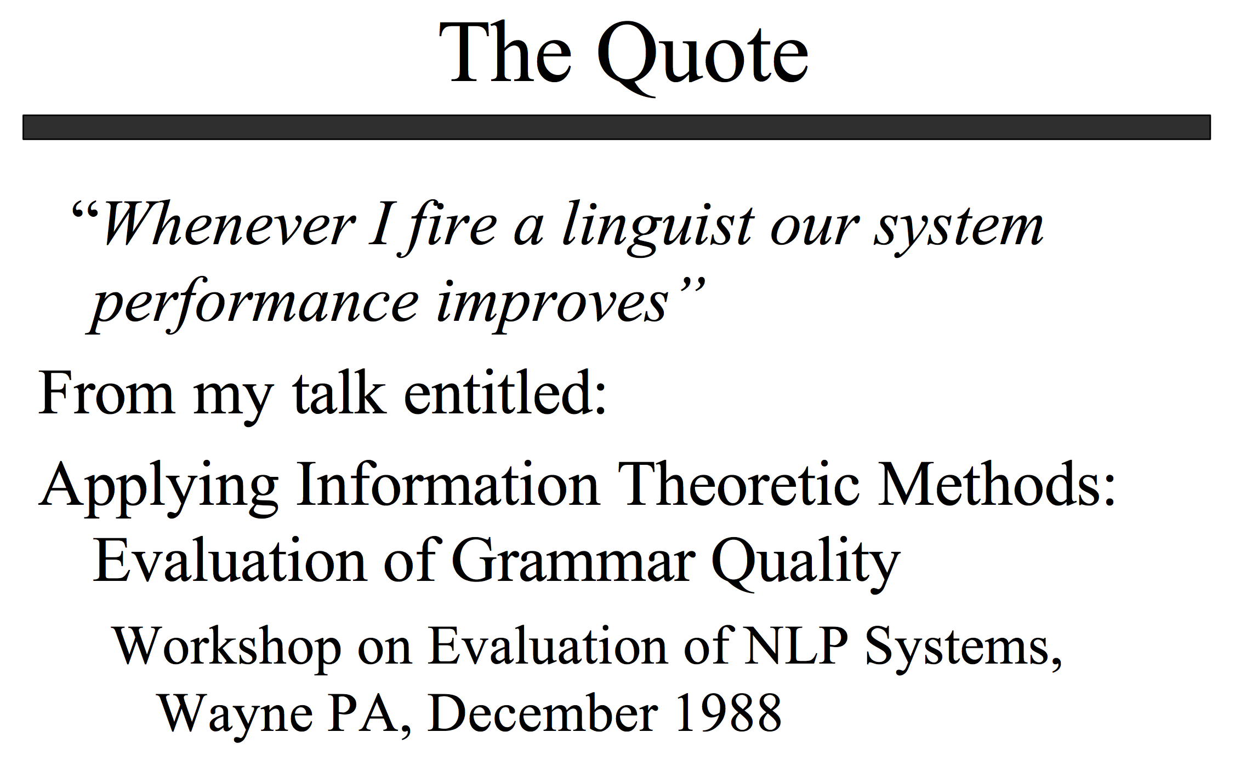
http://www.lrec-conf.org/lrec2004/doc/jelinek.pdf

Slide 49
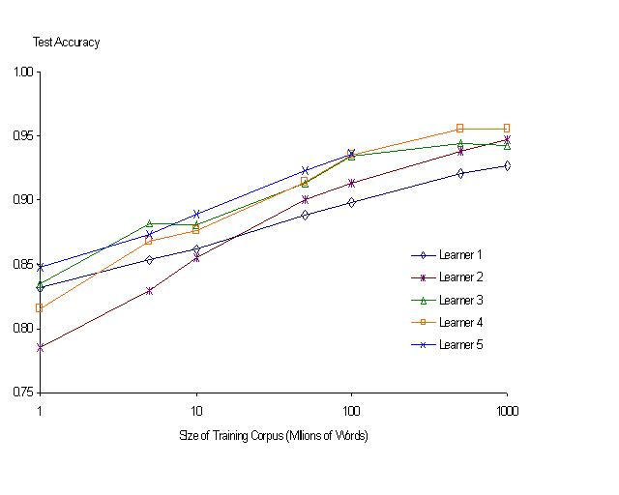
“It never pays to think until you’ve run out of data” – Eric Brill
Moore’s Law Constant:
Data Collection Rates → Improvement Rates
Banko & Brill: Mitigating the Paucity-of-Data Problem (HLT 2001)
No consistently
best learner
There is no data like more data
Quoted out of context
Fire everybody and
spend the money on data

Slide 50
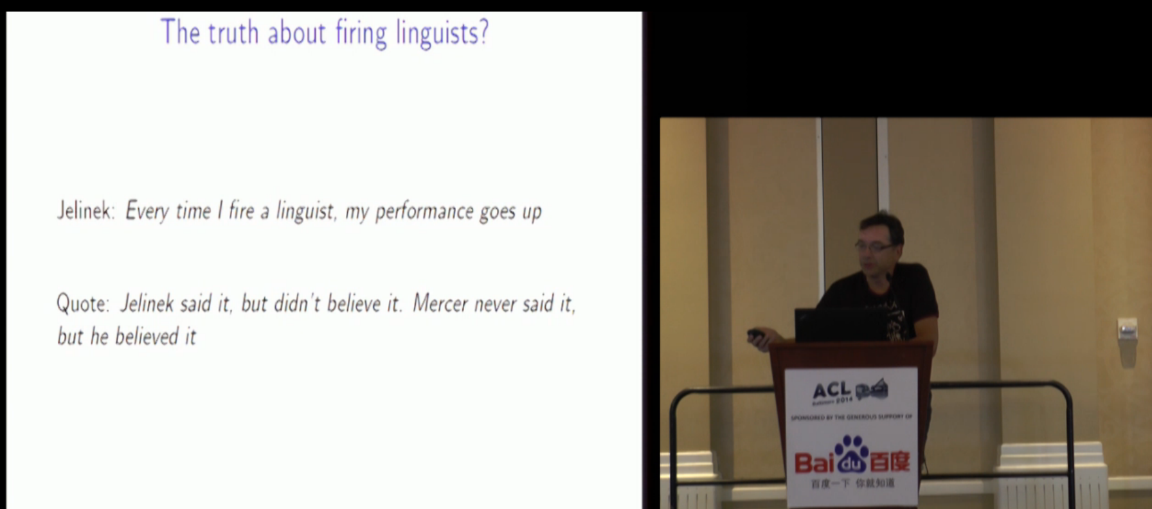
Robert Mercer ACL Lifetime Achievement http://techtalks.tv/talks/closing-session/60532/

Slide 51
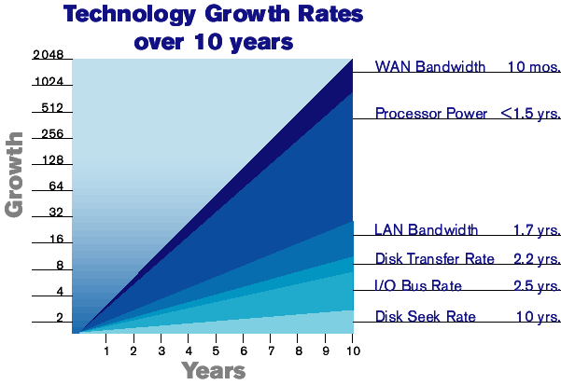
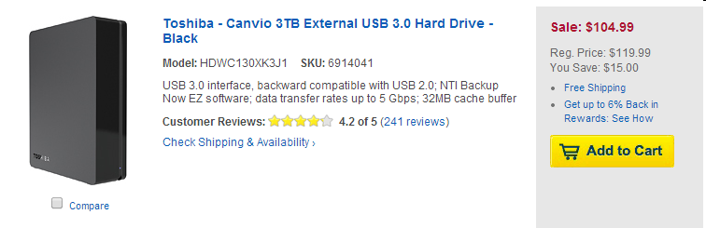
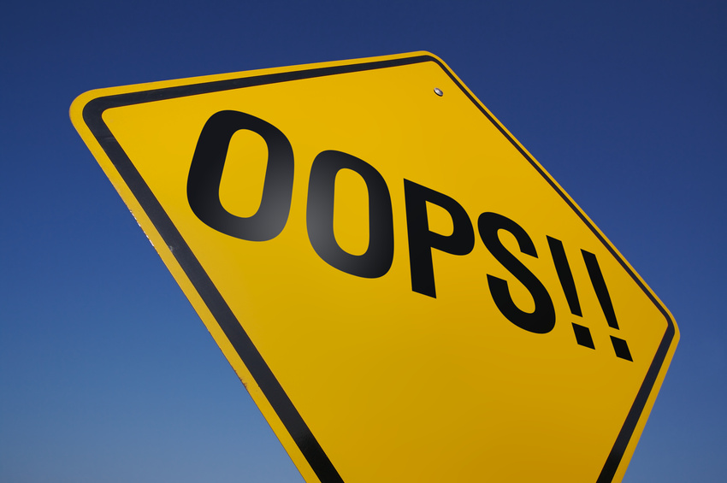

The Disk Space Conjecture
Improvements in Speech, Language (& more)
are indexed to improvements in disk capacities
because disk prices → size of web → training data
2003 Prediction:
Disks improve1000x per decade
1TB: $1k (2003) → $1 (2013)
Missed by 30x (a TB is currently ~ $30 >> $1)

Slide 52

Disk Prices Over 30 Years http://www.jcmit.com/diskprice.htm
191x cheaper per decade (1985-2014)
1750x cheaper per decade (1995-2003)
Flood

Slide 53
Moore’s Law: Different Time Constants for Different Things https://archive.is/3pgVP

Slide 54
Word Association Norms: Doctor / Nurse
Counts are growing 1000x per decade
(same as disks)
Counts are growing 1000x per decade
(same as disks)
Rising Tide of Data Lifts All Boats

Slide 55
Priming & Word Associations Task: Subject is given two strings and responds “yes” if both are words

Slide 56
Pointwise Mutual Information (PMI)
Simple interpretation
PMI compares P(x,y) with chance
Chance = P(x) P(y)
If there is a genuine association
then P(x,y) >> P(x) P(y)
Uninteresting associations
P(x,y) ≈ P(x) P(y)
Popular applications (lexicography)
more like hypothesis testing
focus on largest PMI
where we can reject null hypothesis
null hypo: uninteresting
less like language modeling for speech and machine translation

Slide 57

Windows for computing P(x,y)
Bigrams:
rectangular window with width of 1 word
Ngrams
rectangular window with width of n-1 words
More generally
Windows need not be rectangular
Or symmetric around 0
(Mutual Information is symmetric
but “Association Measure” is not)
Convenient to assume windows sum to 1
More interesting windows
Parse Trees / SVO

Slide 58


OCR Application

Slide 59


Applications in Lexicography

Slide 60



Proper Place for Automation: Start with Drudgery (Support our colleagues; don’t talk too much about taking away jobs they love to do)

Slide 61

Patrick found tables like this very exciting

Slide 62
Save <good> from <bad>

Slide 63
Save good shoppers from their evil $$
Patrick wanted me to “fix” my bug

Slide 64

https://books.google.com/ngrams/graph?content=save+forests+from%2Csave+whales+from%2Csave+the+planet+from%2Csave+the+environment+from&year_start=1800&year_end=2000&corpus=15&smoothing=3&share=&direct_url=t1%3B%2Csave%20forests%20from%3B%2Cc0%3B.t1%3B%2Csave%20whales%20from%3B%2Cc0%3B.t1%3B%2Csave%20the%20planet%20from%3B%2Cc0%3B.t1%3B%2Csave%20the%20environment%20from%3B%2Cc0
Google Ngrams

Slide 65

save from ≠ save X from Y

Slide 66

save from ≠ save X from Y

Slide 68
Plan
Summarize main points of paper
Call out
some highlights of subsequent literature
suggestions for future work

Slide 69

Using Google Scholar to find subsequent work to call out
Text Classification
LSA
Sentiment
Sentiment
Lexicography

Slide 70



Levy & Goldberg (NIPS-2014) Word2Vec ≈ PMI (Pointwise Mutual Info) $sim\left(x,y\right)=\cos\left(vec\left(x\right), vec\left(y\right)\right)≈PMI(x,y)$
What happened in 2014?

Slide 71
Word2vec is popular (massively cited)
Word2vec is not first, last or best to discuss
Vector spaces, embeddings, analogies, similarity metrics, etc.
But word2vec is simple and accessible
Anyone can download the code and use it in their next paper.
Any many do (for better and for worse)
Available downloads
Pre-computed vectors (no training required)
Code for training your own vectors on your own corpora

Slide 72

Salton’s Vector Space Model

Slide 73

Embeddings: Similarity of docs/words ≈ cos (dot product)

Slide 74

Information Retrieval (IR) notation Term Weighting: tf * IDF
t: term
d: document
D: # of documents in library
tf(t,d): term frequency
# of times that t appears in d
df(t): document frequency
# of documents that contain t
(at least once)
IDF(t): inverse doc frequency
$IDF\left(t\right)=−\log_{2}\frac{df(t)}{D}$
tf * IDF weighting
Assumes (too much) indep

Slide 76


LSA/LSI: Latent Semantic Analysis/Indexing SVD: Singular Value Decomposition PCA: Principal Component Analysis
 | c1 | c2 | c3 | c4 | c5 | m1 | m2 | m3 | m4
human | 1 | 0 | 0 | 1 | 0 | 0 | 0 | 0 | 0
interface | 1 | 0 | 1 | 0 | 0 | 0 | 0 | 0 | 0
computer | 1 | 1 | 0 | 0 | 0 | 0 | 0 | 0 | 0
user | 0 | 1 | 1 | 0 | 1 | 0 | 0 | 0 | 0
system | 0 | 1 | 1 | 2 | 0 | 0 | 0 | 0 | 0
response | 0 | 1 | 0 | 0 | 1 | 0 | 0 | 0 | 0
time | 0 | 1 | 0 | 0 | 1 | 0 | 0 | 0 | 0
EPS | 0 | 0 | 1 | 1 | 0 | 0 | 0 | 0 | 0
survey | 0 | 1 | 0 | 0 | 0 | 0 | 0 | 0 | 1
trees | 0 | 0 | 0 | 0 | 0 | 1 | 1 | 1 | 0
graph | 0 | 0 | 0 | 0 | 0 | 0 | 1 | 1 | 1
minors | 0 | 0 | 0 | 0 | 0 | 0 | 0 | 1 | 1
M: term by doc matrix
$M≈UDV^{T}$
Dimension Reduction
s = svd(m)
m2 = s$u[,1:2] %*% diag(s$d[1:2]) %*% t(s$v[,1:2])
dimnames(m2)=dimnames(m)
Bellcore Example

Slide 77


Slide 78


plot(hclust(as.dist(1-cor(m)))
 | c1 | c2 | c3 | c4 | c5 | m1 | m2 | m3 | m4
human | 1 | 0 | 0 | 1 | 0 | 0 | 0 | 0 | 0
interface | 1 | 0 | 1 | 0 | 0 | 0 | 0 | 0 | 0
computer | 1 | 1 | 0 | 0 | 0 | 0 | 0 | 0 | 0
user | 0 | 1 | 1 | 0 | 1 | 0 | 0 | 0 | 0
system | 0 | 1 | 1 | 2 | 0 | 0 | 0 | 0 | 0
response | 0 | 1 | 0 | 0 | 1 | 0 | 0 | 0 | 0
time | 0 | 1 | 0 | 0 | 1 | 0 | 0 | 0 | 0
EPS | 0 | 0 | 1 | 1 | 0 | 0 | 0 | 0 | 0
survey | 0 | 1 | 0 | 0 | 0 | 0 | 0 | 0 | 1
trees | 0 | 0 | 0 | 0 | 0 | 1 | 1 | 1 | 0
graph | 0 | 0 | 0 | 0 | 0 | 0 | 1 | 1 | 1
minors | 0 | 0 | 0 | 0 | 0 | 0 | 0 | 1 | 1

Slide 79

plot(hclust(as.dist(1-cor(t(m))))
 | c1 | c2 | c3 | c4 | c5 | m1 | m2 | m3 | m4
human | 1 | 0 | 0 | 1 | 0 | 0 | 0 | 0 | 0
interface | 1 | 0 | 1 | 0 | 0 | 0 | 0 | 0 | 0
computer | 1 | 1 | 0 | 0 | 0 | 0 | 0 | 0 | 0
user | 0 | 1 | 1 | 0 | 1 | 0 | 0 | 0 | 0
system | 0 | 1 | 1 | 2 | 0 | 0 | 0 | 0 | 0
response | 0 | 1 | 0 | 0 | 1 | 0 | 0 | 0 | 0
time | 0 | 1 | 0 | 0 | 1 | 0 | 0 | 0 | 0
EPS | 0 | 0 | 1 | 1 | 0 | 0 | 0 | 0 | 0
survey | 0 | 1 | 0 | 0 | 0 | 0 | 0 | 0 | 1
trees | 0 | 0 | 0 | 0 | 0 | 1 | 1 | 1 | 0
graph | 0 | 0 | 0 | 0 | 0 | 0 | 1 | 1 | 1
minors | 0 | 0 | 0 | 0 | 0 | 0 | 0 | 1 | 1

Slide 80


LSA maps terms & docs into internal dimensions

Slide 81
Word2vec is popular (massively cited)
Word2vec is not first, last or best to discuss
Vector spaces, embeddings, analogies, similarity metrics, etc.
But word2vec is simple and accessible
Anyone can download the code and use it in their next paper.
Any many do (for better and for worse)
Available downloads
Pre-computed vectors (no training required)
Code for training your own vectors on your own corpora

Slide 82


Word2Vec: $sim\left(x,y\right)=\cos\left(vec\left(x\right), vec\left(y\right)\right)≈PMI(x,y)$ https://code.google.com/archive/p/word2vec/
Linguistic generalizations
Word associations (distance in plot)
Features (red line)
Countries & Capitals
Analogies:
Man : Woman :: King : x
x → queen
Athens : Greece :: Bangkok: x
x → Thailand
Vector Space (Salton)
Addition & subtraction
Clustering, PCA
Convenient for Neural Networks

Slide 83


man : woman :: king : x
Vector addition & subtraction
$vec\left(king+woman −man\right)=vec\left(king\right)+vec\left(woman\right)−vec(man)$
Analogies
$\hat{x}=\underset{x∈V}{ARGMAX}{sim(x^{′}, king+woman −man)}$

Slide 84

Some analogies are easier than others
Tweets
RT @tallinzen: sure, king:queen etc, but did you know word2vec gets real SAT analogies right just 1% of the time?
15 copies of this tweet
Some by NLP experts
Resources Debate
WordNet &
British National Corpora

Slide 85

Levy & Goldberg (NIPS-2014) Word2Vec ≈ PMI (Pointwise Mutual Info)
Levy & Goldberg (NIPS-2014) is a theoretical arg
Plots → correlations are large, but far from perfect
Materials:
N = 22 words (11 cities + 11 countries)
N (N-1)/2 = 231 pairs of words (points)
type in {city, country}
Color:
Green → type match
Red → type mismatch

Slide 86

GloVe: https://nlp.stanford.edu/projects/glove/
Alternative to Word2vec:
Similar performance
Both Word2vec & GloVe ≈ PMI
More interpretable:
Neural net → SGD minimization of a sensible loss
More generous license
Both methods output embedding $M$
$M: V$ by $K$ matrix where $M×M^{T}≈P$
$V$: size of vocabulary
$K$: # of internal dimensions
$P$: $V$ by $V$matrix of PMI values
Space: GloVe materializes a $V^{2}$matrix while computing $M$ (unlike Word2vec)

Slide 87

Glass is half-full/empty Word2vec is similar to PMI (but different)

Slide 88
IMHO: Word2vec & GloVe >> PMI
Glass is half full
Levy & Goldberg are correct in pointing out similarities
But half empty
Word2vec & GloVe do better in practice
Because of “tricks” for small counts, etc.
Code is not well understood
Even though there isn’t much there
702 lines in word2vec.c; 446 in glove.c
Dimension Reduction
Matrix completion (?!?)
Obvious suggestion, SVD on PMIs
Disappointing in practice
May not want to model PMI too well

Slide 89


Estimating PMI (and Contingency Tables) Li & Church, Computational Linguistics (2007)
Compute Sample Contingency Table
MLE Inference:
What is the most likely original table
Given sample and margins?
Evaluation
http://stat.rutgers.edu/home/pingli/

Slide 90


Prior Art: Removing (Near) Duplicate Web Pages

Slide 91

Computing Contingency Tables (Brute Force)
5
7
12
7
17
Three constraints
Library: D = a + b + c + d = 36
Margins
f₁ = |P₁| = a + b = 12
f₂ = |P₂| = a + c = 12
a = |P₁ & P₂| = |{4,15, 19, 24, 28}| = 5
b = f₁ – a = 12 – 5 = 7
c = f₂ – a = 12 – 5 = 7
d = D – a – b – c = 36 – 5 – 7 – 7 = 17
12
36
crux
P₁ | 3 | 4 | 7 | 9 | 10 | 15 | 18 | 19 | 24 | 25 | 28 | 33
P₂ | 2 | 4 | 5 | 8 | 15 | 19 | 21 | 24 | 27 | 28 | 31 | 35

Slide 92
Computing Sample Contingency Table (Using Sketches, An Approximation: Yellow)
Key: throw out red {19, 21}
D_{s} = min(max(sketch(w₁)), max(sketch(w₂))) = 18
Can’t tell that 19 is in intersection and 21 is not
Without looking outside the sketch
Ω_{s} = {1, 2,…,D_{s}}
a_{s} = sketch(w₁) & sketch(w₂) & Ω_{s} = |{4,15}| = 2
b_{s} = |sketch(w₁) & Ω_{s}| – a_{s} = 7 – 2 = 5
c_{s} = |sketch(w₂) & Ω_{s}| – a_{s} = 5 – 2 = 3
d_{s} = Ds – a_{s} – b_{s} – c_{s} = 18 – 2 – 5 – 3 = 8
D_{s} = Sample Size
crux
Sketch = Front of Postings
P₁ | 3 | 4 | 7 | 9 | 10 | 15 | 18 | 19 | 24 | 25 | 28 | 33
P₂ | 2 | 4 | 5 | 8 | 15 | 19 | 21 | 24 | 27 | 28 | 31 | 35
Doc IDs need to be random

Slide 93
MLE Inference: What is the most likely table Given sample and margins?
When we know the margins,
We ought to use them
D_{s}/D = Sampling Rate
Consider all possible contingency tables:
a, b, c & d
Select the table that maximizes the probability of observations
a_{s}, b_{s}, c_{s} & d_{s}

Slide 94

Empirical Evaluation MLE >> MF >> Independence
IND (assume independence):
too much error
MF (Margin-Free)
Target: minimize effort & error
D_{s}/D = Sampling Rate (effort)

Slide 95


Non-Empirical Evaluation (Closed Form)
Non-Empirical Evaluation:
MLE has smaller variance than Margin Free (MF) baseline
Confirms Empirical Evaluation:
MLE has less error than MF
When we have margins, we should use them
Improves accuracy as well as consistency

Slide 96
Sketches vs. Word2Vec (as estimates of PMI)
It is said that word2vec is fast
But sketches are also fast
and closer to PMI
But is closer to PMI better?

Slide 97
Interestingness Metrics: Deviations from Independence
Poisson (and other independence assumptions)
Not bad for meaningless random strings
Deviations from Poisson are clues for hidden variables
Meaning, content, genre, topic, author, etc.
Analogous to mutual information (Hanks)
Pr(doctor…nurse) >> Pr(doctor) Pr(nurse)

Slide 98


Slide 99


Slide 100


Slide 101


Adaptation: Three Approaches
Cache-based adaptation
Parametric Models
Poisson, Two Poisson, Mixtures (neg binomial)
Non-parametric
Pr(+adapt₁) ≡ Pr(test|hist)
Pr(+adapt₂) ≡ Pr(k≥2|k ≥1)

Slide 102
Positive & Negative Adaptation
Adaptation:
How do probabilities change as we read a doc?
Intuition: If a word w has been seen recently
+adapt: prob of w (and its friends) goes way up
−adapt: prob of many other words goes down a little
Pr(+adapt) >> Pr(prior) > Pr(−adapt)

Slide 103
Adaptation: Method 1
Split each document into two equal pieces:
Hist: 1st half of doc
Test: 2nd half of doc
Task:
Given hist
Predict test
Compute contingency table for each word
Documents containing hostages in 1990 AP News
 | test
hist | 638 | 505
 | 557 | 76,787

Slide 104
Adaptation: Method 1
 | test
hist | a | b
 | c | d
Notation
D = a+b+c+d (library)
df = a+b+c (doc freq)
Prior:
+adapt
−adapt
Documents containing hostages
Pr(+adapt) >> Pr(prior) > Pr(−adapt)
+adapt | prior | −adapt | source
0.56 | 0.014 | 0.0069 | AP 1987
0.56 | 0.015 | 0.0072 | AP 1990
0.59 | 0.013 | 0.0057 | AP 1991
0.39 | 0.004 | 0.0030 | AP 1993

Slide 105

Adaptation: Hist >> Near >> Prior
Magnitude is huge
Shape: Given/new
1st mention: marked
Surprising (low prob)
Depends on freq
2nd: unmarked
Less surprising
Independent of freq
Priming:
“a little bit” marked

Slide 106
Adaptation: Method 2
Pr(+adapt₂)
df_{k}(w) ≡ number of docs that
mention word w
at least k times
df₁(w) ≡ standard def of document freq (df)

Slide 107
Pr(+adapt₁) ≈ Pr(+adapt₂) Within factors of 2-3 (as opposed to 10-1000)
3rd mention
Priming

Slide 108
Adaptation is Lexical
Lexical: adaptation is
Stronger for good keywords (Kennedy)
Than random strings, function words (except), etc.
Content ≠ low frequency
+adapt | prior | −adapt | source | word
0.27 | 0.012 | 0.0091 | AP90 | Kennedy
0.40 | 0.015 | 0.0084 | AP91 | Kennedy
0.32 | 0.014 | 0.0094 | AP93 | Kennedy
0.049 | 0.016 | 0.016 | AP90 | except
0.048 | 0.014 | 0.014 | AP91 | except
0.048 | 0.012 | 0.012 | AP93 | except

Slide 109
Adaptation Conclusions
Large magnitude (p/2 >> p²); big quantity discounts
Distinctive shape
1st mention depends on freq
2nd does not
Priming: between 1st mention and 2nd
Lexical:
Independence assumptions aren’t bad for meaningless random strings, function words, common first names, etc.
More adaptation for content words (good keywords, OOV)

Slide 110


Conclusions / Plan
Summarize main points of paper
Call out
some highlights of subsequent literature
Word2vec ≈ PMI (with factoring)
Word2vec ≈ LSA / SVD (similar factoring)
Are there better ways to approximate PMI? Sketches?
suggestions for future work
If the matrix that we are factoring isn't positive definite,
then the optimization might be looking for a solution that may not exist.
It might be useful to generalize the optimization to consider solutions where the left eigenvector need not be the same as the right eigenvector, or where the solution can make use of imaginary numbers.
It is common for embeddings to use K=300 dimensions,
but most words don't appear K times in the corpus.
It is hard to justify K parameters for a word that doesn't appear K times.

Slide 111
backup

Slide 112


s=svd(m) m2 = s$u[,1:2] %*% diag(s$d[1:2]) %*% t(s$v[,1:2]) dimnames(m2) = dimnames(m)
heatmap(m)
heatmap(m2)

Slide 113


